Slide 1




REASONING ANSWERS
Multiplication & Division

Slide 2









Which group of money is the odd one out?
*
Explain why. The first 2 total 12. The last one totals 15

Slide 3


Spot the mistake.
Alex says, “There are 10 equal groups with 2 in each group. There are ten 2s.”
There are 2 equal groups with 10 in each group. There are two 10’s

Slide 4


Has Eva shown the equal groups correctly?
Draw or use cubes to show what Eva should have done.

Slide 5
How can you make the groups equal?

Slide 6




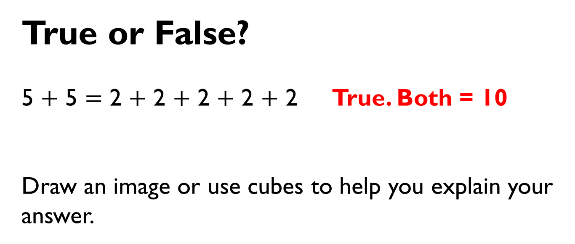
True or False?
5 $+$ 5 $=$ 2 $+$ 2 $+$ 2 $+$ 2 $+$ 2 True. Both = 10
Draw an image or use cubes to help you explain your answer.

Slide 7



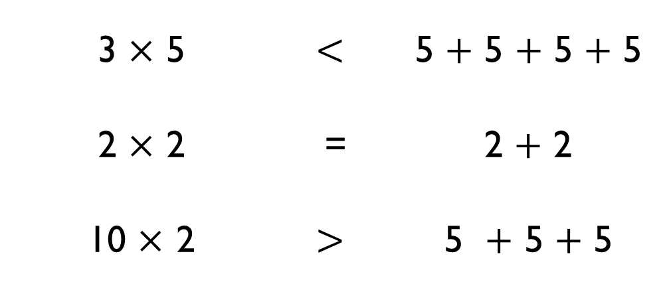
Use $<$, $>$ or $=$ to make the statements correct.
3 $×$ 5 | $$<$$ | 5 $+$ 5 $+$ 5 $+$ 5
2 $×$ 2 | = | 2 $+$ 2
10 $×$ 2 | $$>$$ | 5 $+$ 5 $+$ 5
$$=$$
$$<$$
$$>$$

Slide 8

Think of a multiplication to complete:
6 $+$ 6 $+$ 6 $>$ 2 $×$ 5

Slide 9
The total is 12, what could the addition and multiplication be?
6 + 6 = 12 2 x 6 = 12

Slide 10
There are four baskets.
There are three dolls in each basket.
How many dolls are there altogether? 12
Draw an image and write a calculation to represent the problem. * * * * * * * * * * * * 4 x 3 = 12

Slide 11
Find different ways to solve six lots of three
3+3+3+3+3+3 6 x 3

Slide 12
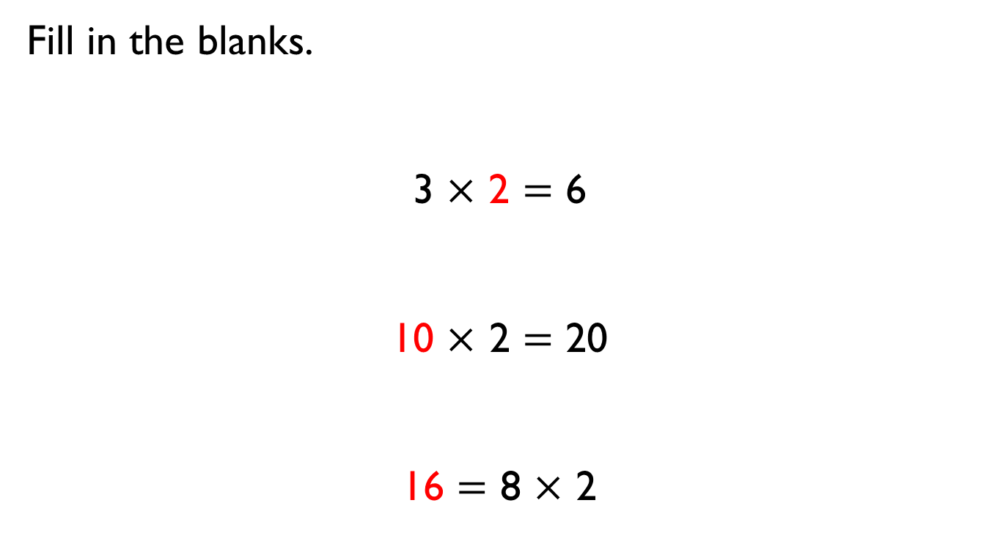
Fill in the blanks.
3 $×$ 2 $=$ 6
10 $×$ 2 $=$ 20
16 $=$ 8 $×$ 2

Slide 13
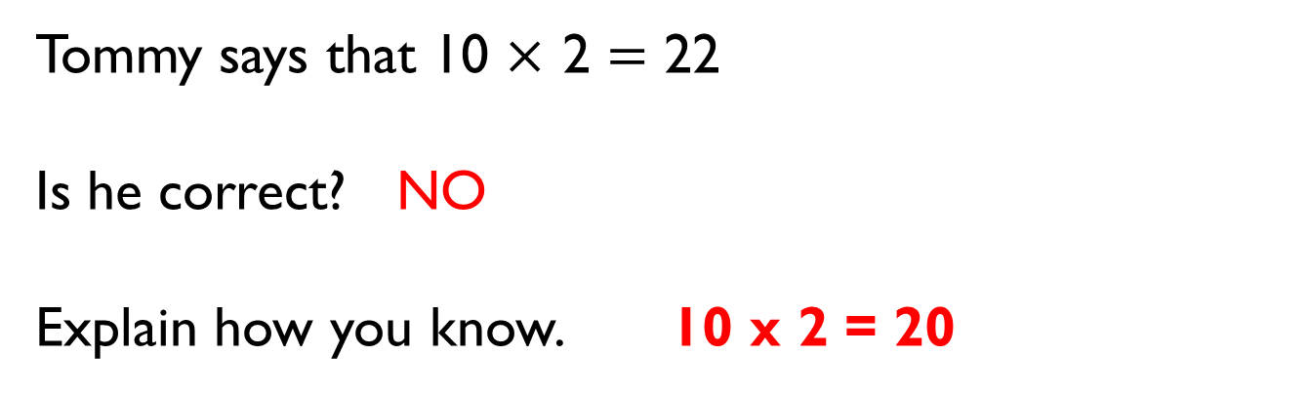
Tommy says that 10 $×$ 2 $=$ 22
Is he correct? NO
Explain how you know. 10 x 2 = 20

Slide 14

Eva says,
Is she correct? Yes Explain your answer.
2 4 6 8 10 12 14 16 18 20 All even
Eva
Every number in the 2 times-table is even.

Slide 15

Is Mo correct? No
Explain your answer. They are odd and even
5 odd 10even 15 odd 20 even 25 odd 30 even
Mo
Every number in the 5 times-table is odd.

