Slide 1




REASONING QUESTIONS
Multiplication & Division

Slide 2









Which group of money is the odd one out?
Explain why.

Slide 3


Spot the mistake.
Alex says, “There are 10 equal groups with 2 in each group. There are ten 2s.”

Slide 4



Has Eva shown the equal groups correctly?
Draw or use cubes to show what Eva should have done.

Slide 5
How can you make the groups equal?

Slide 6




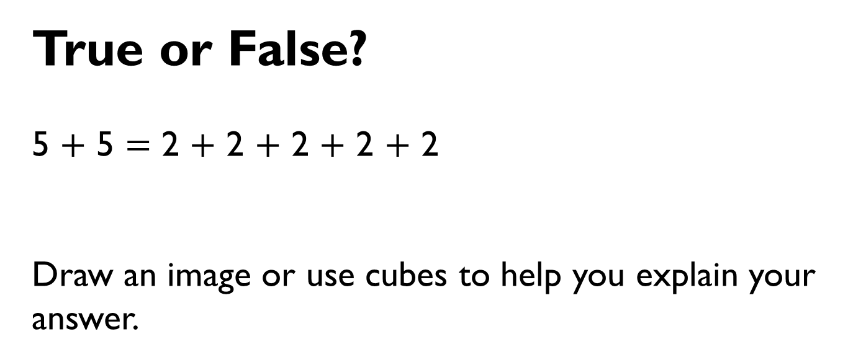
True or False?
5 $+$ 5 $=$ 2 $+$ 2 $+$ 2 $+$ 2 $+$ 2
Draw an image or use cubes to help you explain your answer.

Slide 7



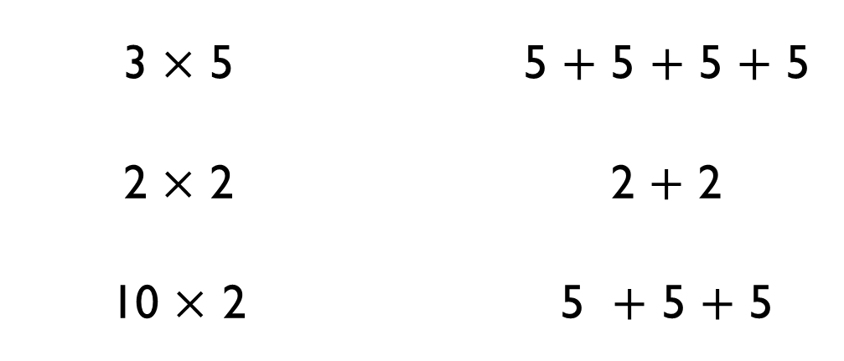
Use $<$, $>$ or $=$ to make the statements correct.
3 $×$ 5 |  | 5 $+$ 5 $+$ 5 $+$ 5
2 $×$ 2 |  | 2 $+$ 2
10 $×$ 2 |  | 5 $+$ 5 $+$ 5
$$=$$
$$<$$
$$>$$

Slide 8

Think of a multiplication to complete:
6 $+$ 6 $+$ 6 $>$ ___ $×$ ___

Slide 9
The total is 12, what could the addition and multiplication be?

Slide 10
There are four baskets.
There are three dolls in each basket.
How many dolls are there altogether?
Draw an image and write a calculation to represent the problem.

Slide 11
Find different ways to solve six lots of three.

Slide 12
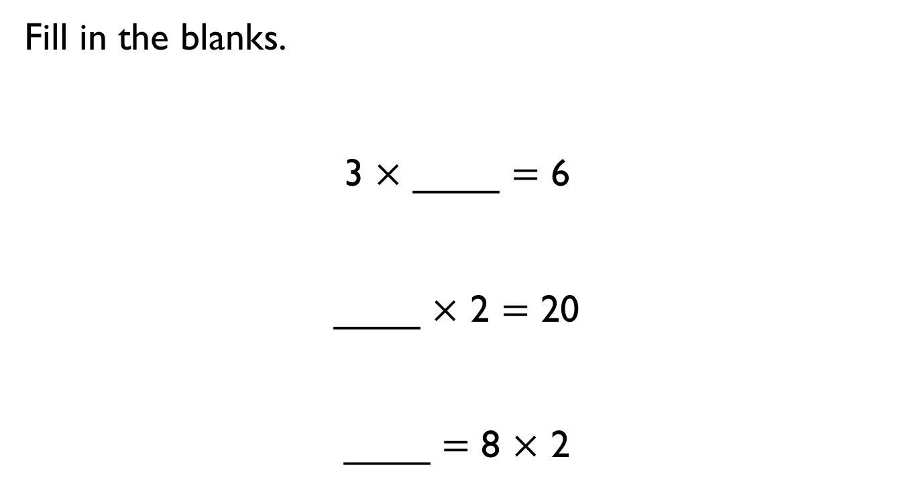
Fill in the blanks.
3 $×$ ____ $=$ 6
____ $×$ 2 $=$ 20
____ $=$ 8 $×$ 2

Slide 13
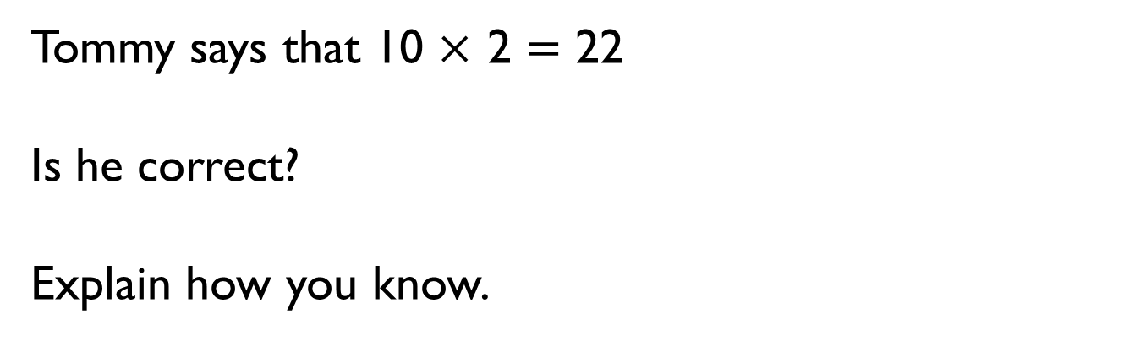
Tommy says that 10 $×$ 2 $=$ 22
Is he correct?
Explain how you know.

Slide 14

Eva says,
Is she correct? Explain your answer.
Eva
Every number in the 2 times-table is even.

Slide 15

Is Mo correct?
Explain your answer.
Mo
Every number in the 5 times-table is odd.

