Slide 1




Multiplication & Division
Reasoning ANSWERS

Slide 2




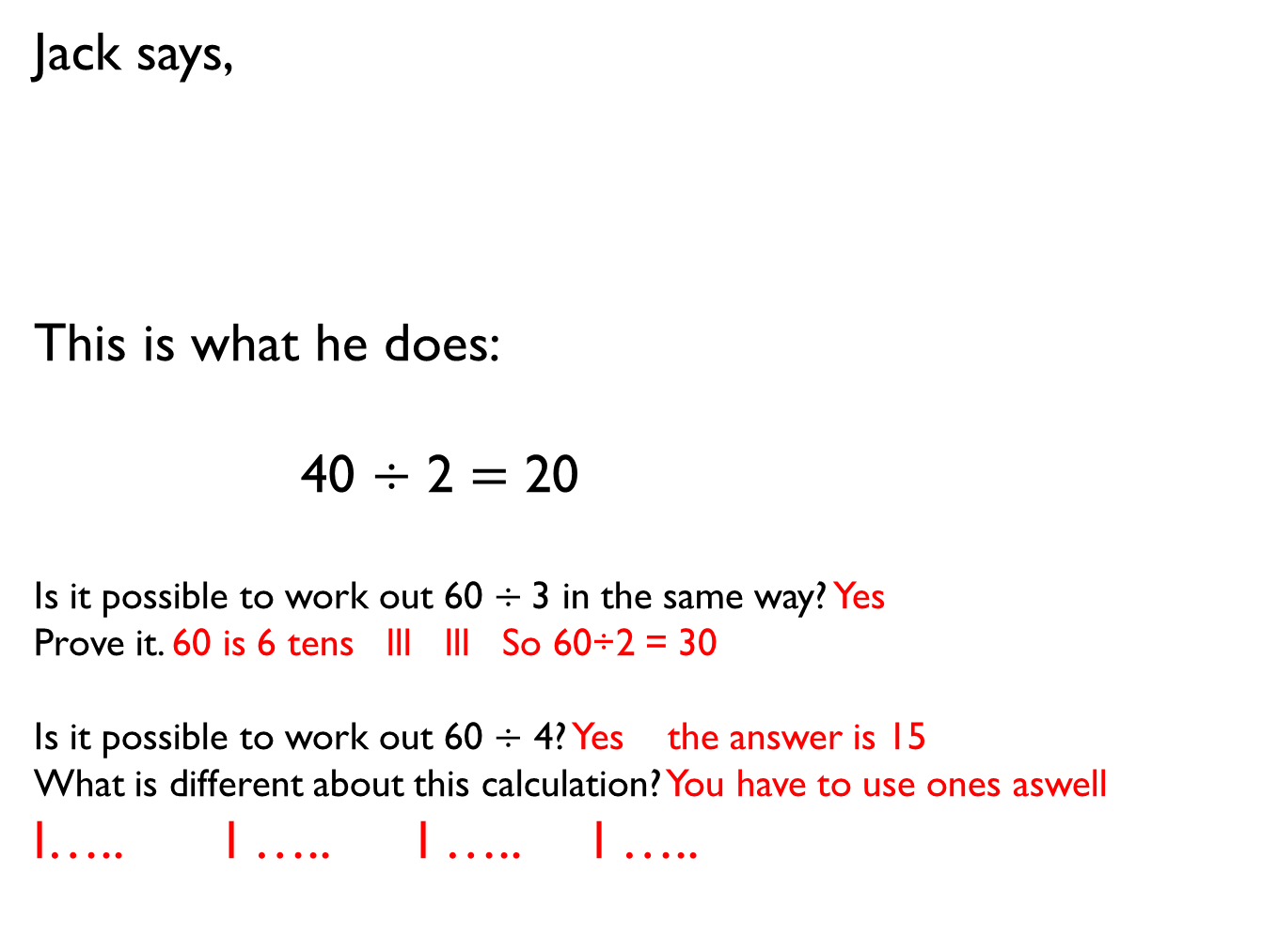
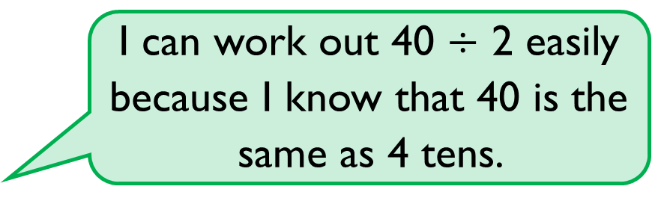
Jack says,
This is what he does:
40 $÷$ 2 $=$ 20
Is it possible to work out 60 $÷$3 in the same way? Yes
Prove it. 60 is 6 tens lll lll So 60÷2 = 30
Is it possible to work out 60 $÷$ 4? Yes the answer is 15
What is different about this calculation? You have to use ones aswell
l….. l ….. l ….. l …..
I can work out 40 $÷$ 2 easily because I know that 40 is the same as 4 tens.

Slide 3

Alex has 20 sweets and shares them between 5 friends. 20 ÷ 5 = 4 each
Tommy has 20 sweets and shares them between 10 friends. 20 ÷ 10 = 2 each
Whose friends will receive the most sweets? Alex
How do you know? 20 ÷ 5 = 4 each
20 ÷ 10 = 2 each

Slide 4
You have 30 counters.
How many different ways can you put them into equal groups?
2 groups of 15 3 groups of 10 5 groups of 6
15 groups of 2 10 groups of 3 6 groups of 5

Slide 5

Amir has some counters.
He makes 5 equal groups.
The amount he started with
is greater than 10 but less
than 35
How many counters could he have started with?
15 20 25 30
How many will be in each group? 15 = 3 in each group
20 = 4 in each group 25 = 65 in each group 30 = 6 in each group

Slide 6





I have 24 p.
I divide it equally between 2 friends.
How much will they get each? 12p
I have 24 p in 2 p coins.
How many 2 p coins do I have? 12
Consider the two questions above.
What is the same and what is different?
They are both 24 ÷ 2 = 12
One is friends = 12 One is money = 12p

Slide 7
Tommy and Annie have some counters.
Tommy shares his counters into 2 equal groups.
He has 15 in each group. = 2 x 15 = 30 30 ÷ 2= 15
Annie groups her counters in twos.
She has 19 groups. 2 x 19 = 38 38 ÷ 19 = 2
Who has more counters and by how many? Annie has 8 more counters
How did you work it out?

Slide 8



Ron has shared some grapes equally between two friends.
Each friend receives fewer than 50 grapes.
Complete the sentences to describe the number of grapes Ron started with.
He must have started with… 98 grapes
He could have started with…96 grapes
He can’t have started with… 100 grapes

Slide 9










True or false?
12 is an odd number. False
Prove your answer using concrete, pictorial and abstract representations.
Numbers go odd even odd even……11 is odd so 12 must be even
12 can be divided by 2 Odd numbers can’t
÷ 2 =
Explain each approach.

Slide 10



Tommy says that when he adds two odd numbers together, his total will be even.
Is he correct? Yes
Convince me.
1 + 3 = 4 (even)
3 + 3 = 6 (even)
5 + 3 = 8 (even)
4 + 6 = 10 (even)
What else can you find out? Even and even = even

Slide 11


A party bag contains 5 sweets.
A jar contains 5 party bags.
Ron has 75 sweets.
How many party bags will he need? 15
How many jars will he need? 3

Slide 12
Use the number cards to make multiplication and division sentences.
How many can you make?
20 ÷ 2 = 10 20 ÷ 10 = 2 20 ÷ 5 = 4 20 ÷ 4 = 5
10 ÷ 5 = 2 10 ÷ 2 = 5
2 x 5 = 10 10 x 2 = 20 4 x 5 = 20
5 x 2 = 10 2 x 10 = 20 5 x 4 = 20
2
20
5
10
4

Slide 13
Mrs Owen has some sweets.
She shares them equally between 10 tables.
How many sweets could each table have? 10 20 30 40 50 60 70 80 90 100
Find as many ways as you can.
What do you notice about your answers? They are multiples of 10

Slide 14
True or false?
Dividing by 10 is the same as dividing by 5 then dividing by 2 True
20 ÷ 10 = 2 20 ÷ 5 = 4 4 ÷ 2 = 2

Slide 15



Cakes are sold in boxes of 10
Jack and Alex are trying to pack these cakes into boxes.
Who is correct? Explain how you know. Alex is correct. Jack has 5 groups of 12
There are 5 groups of 10
There are 6 groups of 10
Jack
Alex

