Slide 1




Year 2
Reasoning 6 – Time - ANSWERS

Slide 2
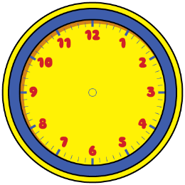



Dora
Amir
Can you spot the mistake they’ve made? Amir is an hour late and Dora has read the hands back to front
Who is telling the time correctly? Alex
The time is half past 6
The time is half past 3
The time is half past 2

Slide 3
Alex
Is Alex correct? No
Explain your reasoning The hour hand should have moved to half way between 11 and 12
It is half past 11 so the hour hand should be on the 11

Slide 4

Oh no! The minute hand has fallen off the classroom clock!
Lunchtime is at 12:00
Have the children missed their lunchtime? Yes because the hour hand (short one) should be on the 12 at 12:00 and it has gone past it. It must be about 20 past 12, so they are late for lunch.

Slide 5

Do you agree with Teddy? No
Explain why.
Quarter to 7 is later than quarter past 6;
quarter to 5 is later than quarter past 4;
quarter to 4 is later than quarter past 3 etc.
Quarter past is always later than quarter to.

Slide 6
How many quarters of an hour are between 7 o’clock and 9 o’clock. 8
Explain how you found the answer.
Between 7 and 9 is 2 hours = 120 minutes
Quarter of an hour is 15 minutes.
There are 4 lots of 15 in 1 hour (60 mins)
There are 8 lots of 15 in 2 hours (120 mins)
or
There are 4 quarters in 1 hour so there must be 8 quarters in 2 hours

Slide 7

The train to Blackpool leaves at quarter past and quarter to every hour.
Make a list of the times of the trains Oliver can catch if he gets to the train station between 2 o’clock and half past 4
quarter past 2 quarter to 3 quarter past 3 quarter to 4
quarter past 4

Slide 8
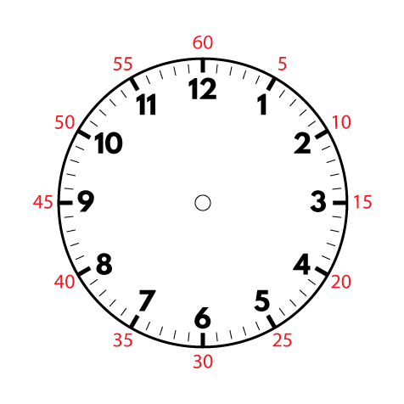
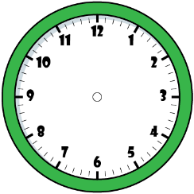

Dora
Amir
Alex
Who is correct? Explain your answer. Alex is correct. Dora is an hour to early and Amir has read the hands the wrong way round.
It is ten to one.
It is ten past ten.
It is ten to two.

Slide 9

Do you agree with Rosie? Explain why. No because four lots of five makes 20 and quarter of an hour is 15 minutes.
Four lots of 5 minutes is the same as quarter of an hour.

Slide 10

Sophia starts her Maths questions at 10 past 11
Each question takes her 5 minutes to complete.
She completes 7 questions.
What time does Sophia finish her Maths questions?
Explain how you found the answer. She finishes at quarter to 12. I counted 7 lots of 5 minutes and landed on 9. This would be quarter to 12

Slide 11
Rosie
Do you agree with Rosie? Prove it. True
7-10am move on 3 hours = 10-10am
4-40pm move on 3 hours = 7-40 pm
The minutes will be the same
If you add three hours onto the current time, the amount of minutes to/past the hour do not change.

Slide 12
The clocks show the start and end time of the film Super Dog.
The film Crazy Cat starts at quarter past 1 and ends at quarter to 3
Teddy says,
Do you agree with Teddy? No – Super Dog starts later than Crazy Cat. They are both the same length = 1 ½ hours long
Super Dog must be the longest film, because it ends the latest.

Slide 13
Rosie has an hour for her lunch break.
If she takes 10 minutes to eat her lunch, does she have enough time to complete all of the playground activities? No
How do you know? An hour is 60 mins. Take away 10 mins to eat her lunch = 50 mins. 7 + 10 + 21 + 19 = 57 mins. She hasn’t enough time.
Activity | Duration
Skipping | 7 minutes
Ball skills | 10 minutes
Treasure hunt | 21 minutes
Trim trail | 19 minutes

