Slide 1




Year 2 - Summer - Block 3
Reasoning 6 - Time

Slide 2
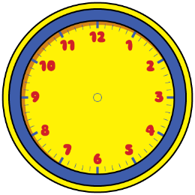



Dora
Amir
Alex
Can you spot the mistake they’ve made?
Who is telling the time correctly?
The time is half past 6
The time is half past 3
The time is half past 2

Slide 3
Alex
Is Alex correct?
Explain your reasoning
It is half past 11 so the hour hand should be on the 11

Slide 4

Oh no! The minute hand has fallen off the classroom clock!
Lunchtime is at 12:00
Have the children missed their lunchtime?

Slide 5

Do you agree with Teddy?
Explain why.
Quarter past is always later than quarter to.

Slide 6
How many quarters of an hour are between 7 o’clock and 9 o’clock.
Explain how you found the answer.

Slide 7

The train to Blackpool leaves at quarter past and quarter to every hour.
Make a list of the times of the trains Oliver can catch if he gets to the train station between 2 o’clock and half past 4

Slide 8
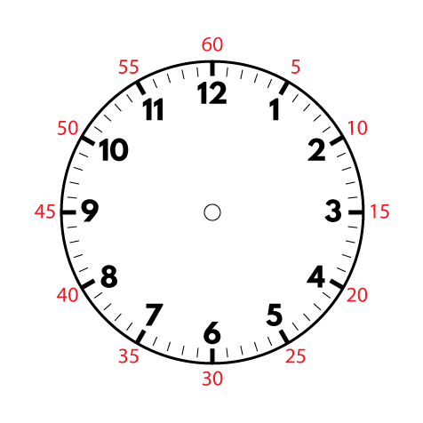
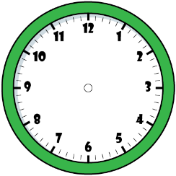

Dora
Amir
Alex
Who is correct? Explain your answer.
It is ten to one.
It is ten past ten.
It is ten to two.

Slide 9

Do you agree with Rosie? Explain why.
Four lots of 5 minutes is the same as quarter of an hour.

Slide 10

Sophia starts her Maths questions at 10 past 11
Each question takes her 5 minutes to complete.
She completes 7 questions.
What time does Sophia finish her Maths questions?
Explain how you found the answer.

Slide 11
Rosie
Do you agree with Rosie? Prove it.
If you add three hours onto the current time, the amount of minutes to/past the hour do not change.

Slide 12
The clocks show the start and end time of the film Super Dog.
The film Crazy Cat starts at quarter past 1 and ends at quarter to 3
Teddy says,
Do you agree with Teddy?
Explain why.
Super Dog must be the longest film, because it ends the latest.

Slide 13
Rosie has an hour for her lunch break.
If she takes 10 minutes to eat her lunch, does she have enough time to complete all of the playground activities?
How do you know?
Activity | Duration
Skipping | 7 minutes
Ball skills | 10 minutes
Treasure hunt | 21 minutes
Trim trail | 19 minutes

