Slide 1

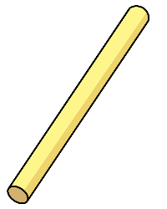
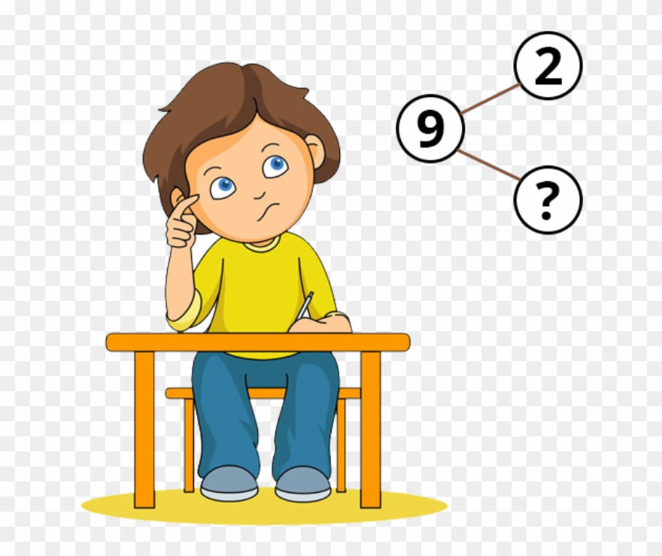


Slide 2


Jack says he has 61
Is he correct?
Explain your reasoning.
He is wrong because there is only 1 ten and 6 ones that makes 16.

Slide 3


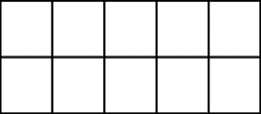
Here are two sets of objects.
Which are easier to count?
Explain your answer. The strawberries because you can can count them in tens and ones 10 + 6 = 16

Slide 4


Each jar contains 10 cookies.
How many cookies are there altogether?
48 forty eight
Write your answer in numerals and words.
What strategy did you use? Count the tens and then the ones
10
10
10
10

Slide 5
Where would 36 go on each of the number lines?
36
36
0
100
0
40

Slide 6








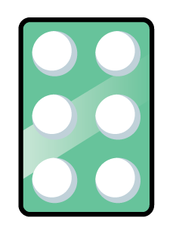

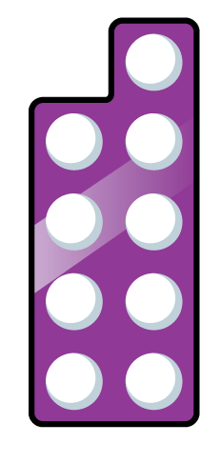

One of these images does not show 23
Can you explain the mistake? C - There are 3 tens and 2 ones = 32
A
B
C

Slide 7



How many two digit numbers can you
make using the digit cards? 4 – 70 72 27 20
What is the largest number? 72
What is the smallest number? 20
7
0
2

Slide 8
Complete each part-whole model in a different way.
6 tens
and
4 ones
60
4
64
50
14
24
40
64

Slide 9

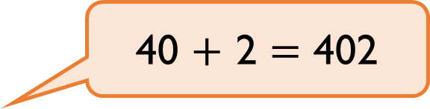
Teddy thinks that,
Explain the mistake he has made. He has put the numbers together incorrectly. It should be 42
40 $+$ 2 $=$ 402

Slide 10
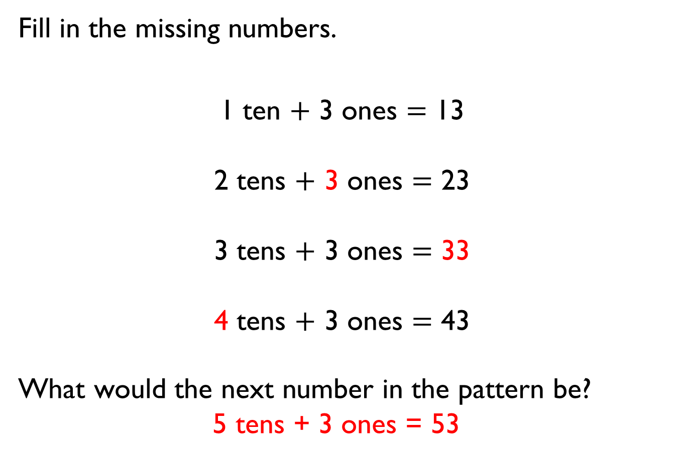
Fill in the missing numbers.
1 ten $+$ 3 ones $=$ 13
2 tens $+$ 3 ones $=$ 23
3 tens $+$ 3 ones $=$ 33
4 tens $+$ 3 ones $=$ 43
What would the next number in the pattern be?
5 tens + 3 ones = 53

Slide 11
Do both place value charts show the same value? Yes
What is the same? They both make 41
What is different? The first one is 4 tens and 1 one which makes 41; the second is 3 tens and 11 ones which makes 41
A
Tens | Ones
B
Tens | Ones

Slide 12

Rosie and Amir are comparing numbers they have made.
Is Rosie correct? No
Explain your answer. She only has 36 whereas Amir has 40
My number is greater because I have more objects.

Slide 13
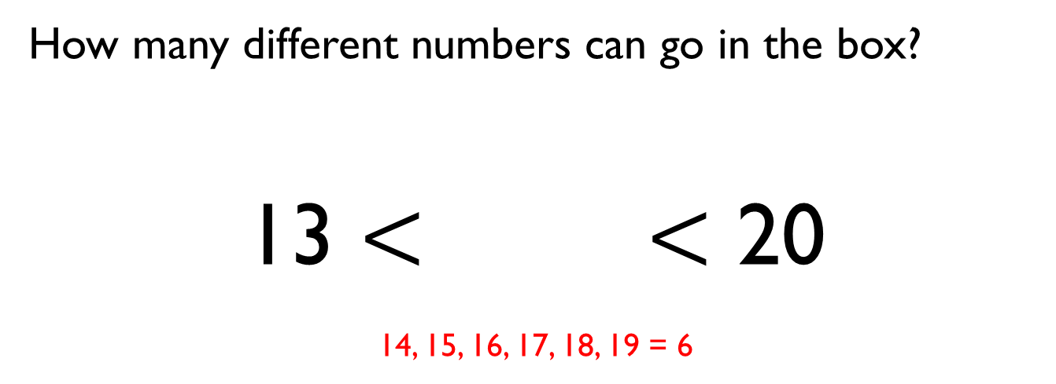
How many different numbers can go in the box?
13 $<$ $<$ 20
14, 15, 16, 17, 18, 19 = 6

Slide 14
True or False?
One ten and twelve ones is bigger than 2 tens.
Explain how you know. True
because one ten and 12 ones = 22 and 2 tens = 20

Slide 15

Eva says,
Do you agree? No – the number with the highest number of tens will be the highest 27/72 38/83
Give some examples to support your answer.
When comparing numbers, the number with the highest number of ones is always the bigger number.

Slide 16
Order the numbers below.
Which would be the fourth number?
37 is the fourth number
Explain how you ordered them. Looking at the tens and then the ones
29
33
34
37
43
53

Slide 17
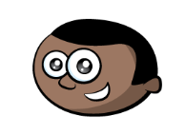
Mo has written a list of 2-digit numbers.
Can you find all the numbers Mo could have written?
14, 41, 23, 32 = 4
Write the numbers in order from smallest to largest.
14 23 32 41
What strategy did you use? Looked at the tens first and then the ones.
The digits of each number add up to five.
None of the digits are zero.

Slide 18
Eva says,
Do you agree with Eva? Yes
Prove it. 5 10 15 20 25 30 35 40 45 50 etc
If you count in 5s from any number in the five times table, your numbers will end in 5 or 0

Slide 19
Always, Sometimes, Never
When counting in 2s from zero the numbers are even. Always
When counting in 5s from zero the numbers are even.Sometimes
When counting in 10s from zero the numbers are even. Always

Slide 20

True or False?
Explain your answer. No 3 6 9 12 15
I start at 0 and count in 3s
I say the number 14

Slide 21
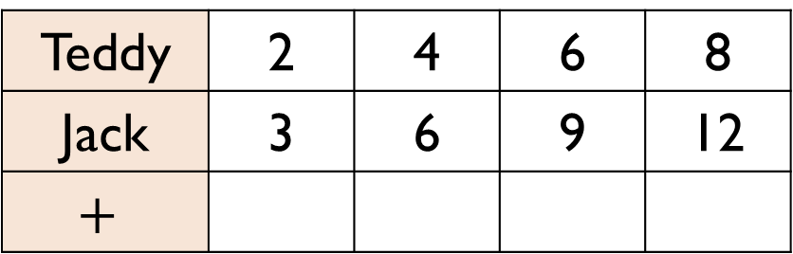
Teddy is counting in 2s and Jack is counting in 3s.
Teddy says,
What pattern do they make? The 5 times table
What happens if both Teddy and Jack count in 5s and they add them together to make a new pattern? They make the 10 times table
Teddy | 2 | 4 | 6 | 8
Jack | 3 | 6 | 9 | 12
$$+$$
If we add our numbers together as we count we can make a new number pattern.

