Slide 1



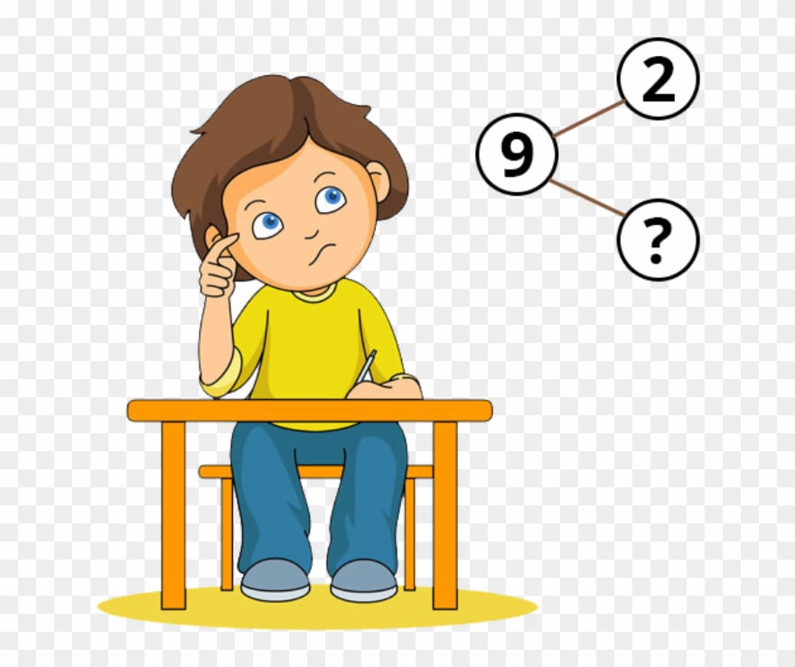
REASONING
Write the answers in your workbook.
Mark your own work using the ANSWERS powerpoint

Slide 2


Jack says he has 61
Is he correct?
Explain your reasoning.

Slide 3


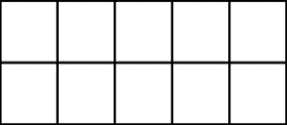
Here are two sets of objects.
Which are easier to count?
Explain your answer.

Slide 4


Each jar contains 10 cookies.
How many cookies are there altogether?
Write your answer in numerals and words.
What strategy did you use?
Did your partner use a different method?
What is the best strategy to use?
10
10
10
10

Slide 5
Where would 36 go on each of the number lines?
0
100
0
40
30
40

Slide 6












One of these images does not show 23
Can you explain the mistake?
A
B
C

Slide 7



How many two digit numbers can you
make using the digit cards?
What is the largest number?
Prove it by using concrete resources.
What is the smallest number?
Prove it by using concrete resources.
Why can’t the 0 be used as a tens number?
7
0
2

Slide 8
Complete each part-whole model in a different way.
6 tens
and
4 ones
64
64

Slide 9


Teddy thinks that,
Explain the mistake he has made.
Can you show the correct answer using
concrete resources?
40 $+$ 2 $=$ 402

Slide 10
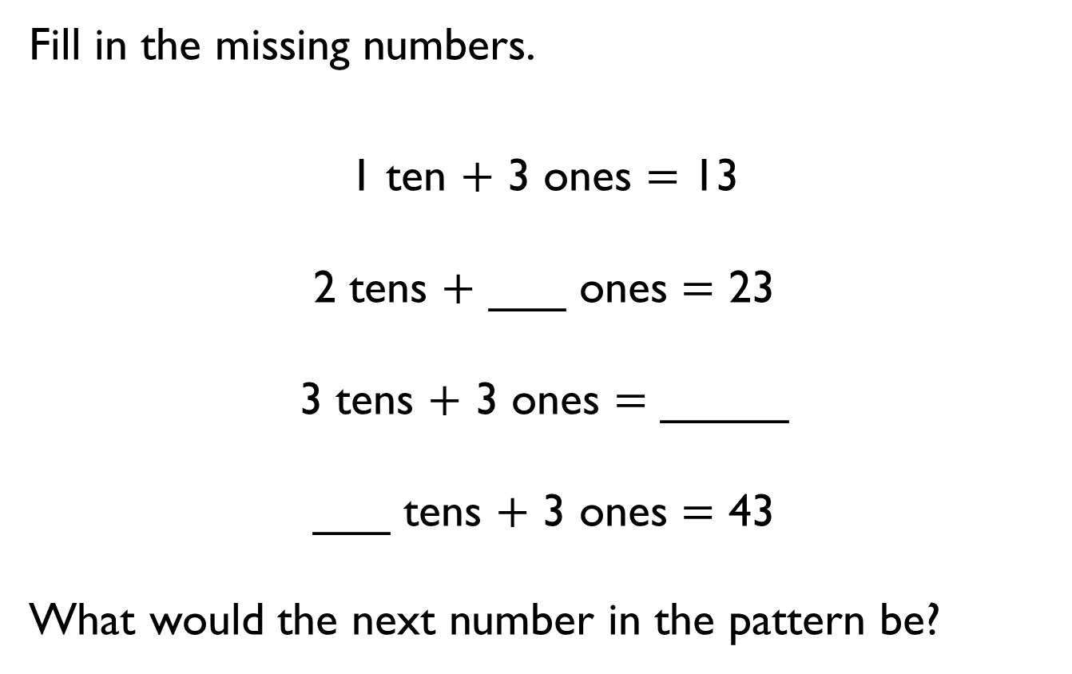
Fill in the missing numbers.
1 ten $+$ 3 ones $=$ 13
2 tens $+$ ___ ones $=$ 23
3 tens $+$ 3 ones $=$ _____
___ tens $+$ 3 ones $=$ 43
What would the next number in the pattern be?

Slide 11
Do both place value charts show the same value?
What is the same?
What is different?
A
Tens | Ones
B
Tens | Ones

Slide 12

Rosie and Amir are comparing numbers they have made.
Is Rosie correct?
Explain your answer.
My number is greater because I have more objects.

Slide 13
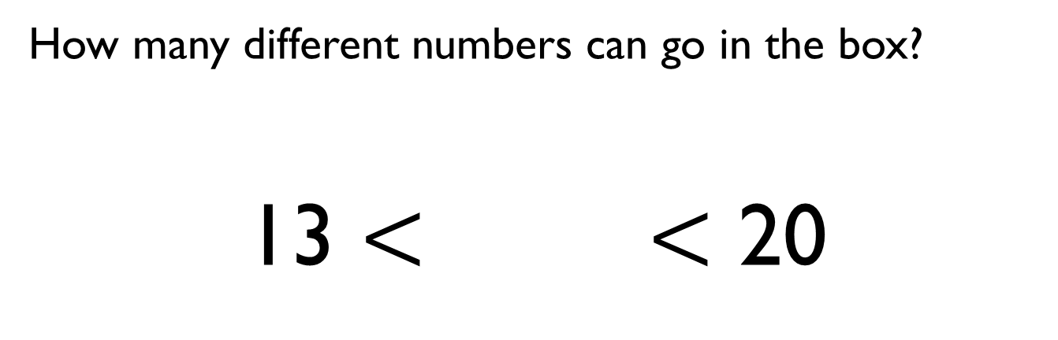
How many different numbers can go in the box?
13 $<$ $<$ 20

Slide 14
True or False?
One ten and twelve ones is bigger than 2 tens.
Explain how you know.

Slide 15

Eva says,
Do you agree?
Give some examples to support your answer.
When comparing numbers, the number with the highest number of ones is always the bigger number.

Slide 16
Order the numbers below.
Which would be the fourth number?
Explain how you ordered them.
33
53
37
29
34
43

Slide 17

Mo has written a list of 2-digit numbers.
Can you find all the numbers Mo could have written?
Write the numbers in order from smallest to largest.
What strategy did you use?
The digits of each number add up to five.
None of the digits are zero.

Slide 18
Eva says,
Do you agree with Eva?
Prove it.
If you count in 5s from any number in the five times table, your numbers will end in 5 or 0

Slide 19
Always, Sometimes, Never
When counting in 2s from zero the numbers are even.
When counting in 5s from zero the numbers are even.
When counting in 10s from zero the numbers are even.

Slide 20

True or False?
Explain your answer.
I start at 0 and count in 3s
I say the number 14

Slide 21
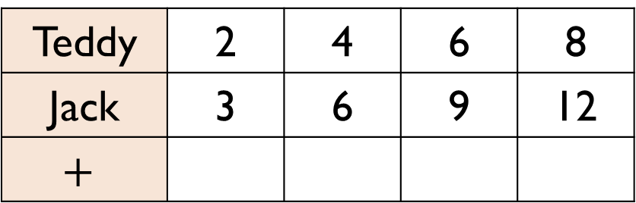
Teddy is counting in 2s and Jack is counting in 3s.
Teddy says,
What pattern do they make?
What happens if both Teddy and Jack count in 5s and they add them together to make a new pattern?
Teddy | 2 | 4 | 6 | 8
Jack | 3 | 6 | 9 | 12
$$+$$
If we add our numbers together as we count we can make a new number pattern.

