Slide 1




Year 2 - Autumn - Block 2
REASONING 2 - Addition & Subtraction ANSWERS

Slide 2


Here is an incomplete bar model.
The total is greater than 10 but less than 20
What could the missing numbers be? 7,11 8,12 9,13 10,14 11,15 12,16 13, 17 14,18 15, 19
How many different combinations can you find? 9
4

Slide 3
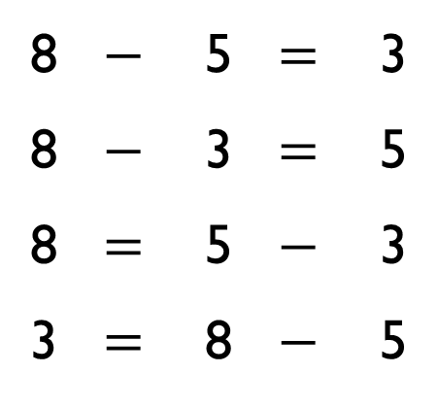

Rosie says,
Ron disagrees.
Who is correct? Can you prove it? Ron is correct because 8 = 5 – 3 is incorrect
8 | $$−$$ | 5 | $$=$$ | 3
8 | $$−$$ | 3 | $$=$$ | 5
8 | $$=$$ | 5 | $$−$$ | 3
3 | $$=$$ | 8 | $$−$$ | 5
I think that all of these facts are correct because the numbers are related

Slide 4
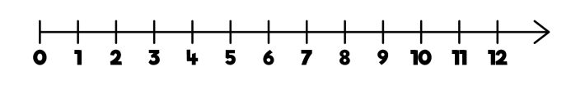
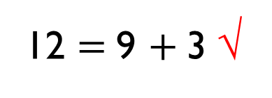
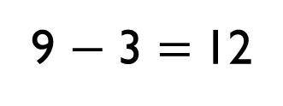
Which of the representations are equivalent to the bar model?
12
3 | 9
12 $=$ 9 $+$ 3 √
There are 9 cars in a car park, 3 cars leave.
9 − 3 $=$ 12
− 3
√

Slide 5
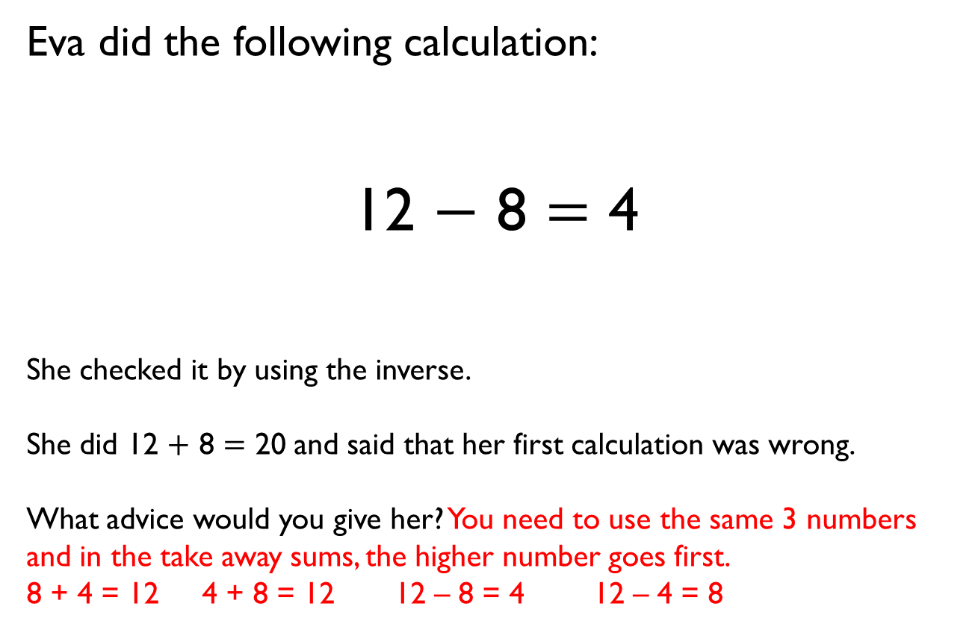
Eva did the following calculation:
12 $−$ 8 $=$ 4
She checked it by using the inverse.
She did 12 $+$ 8 $=$ 20 and said that her first calculation was wrong.
What advice would you give her? You need to use the same 3 numbers and in the take away sums, the higher number goes first.
8 + 4 = 12 4 + 8 = 12 12 – 8 = 4 12 – 4 = 8

Slide 6

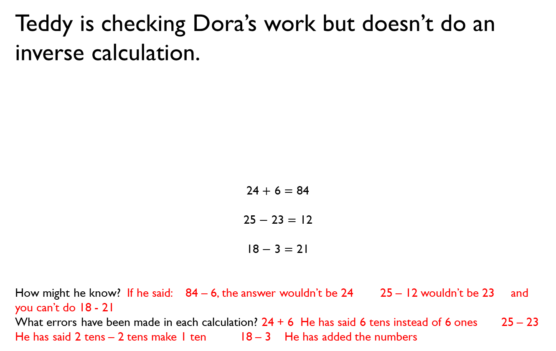
Teddy is checking Dora’s work but doesn’t do an inverse calculation.
24 $+$ 6 $=$ 84
25 $−$ 23 $=$ 12
18 $−$ 3 $=$ 21
How might he know? If he said: 84 – 6, the answer wouldn’t be 24 25 – 12 wouldn’t be 23 and you can’t do 18 - 21
What errors have been made in each calculation? 24 + 6 He has said 6 tens instead of 6 ones 25 – 23 He has said 2 tens – 2 tens make 1 ten 18 – 3 He has added the numbers
These calculations can’t be right.

Slide 7
Rosie thinks she knows the missing number without calculating the answer.
Can you explain how this could be possible? She has looked for a pattern. 8 has stayed the same but 15 has gone up by 2, so the missing number needs to be 7 + 2 which is 9
15
17
8
7
8
?

Slide 8
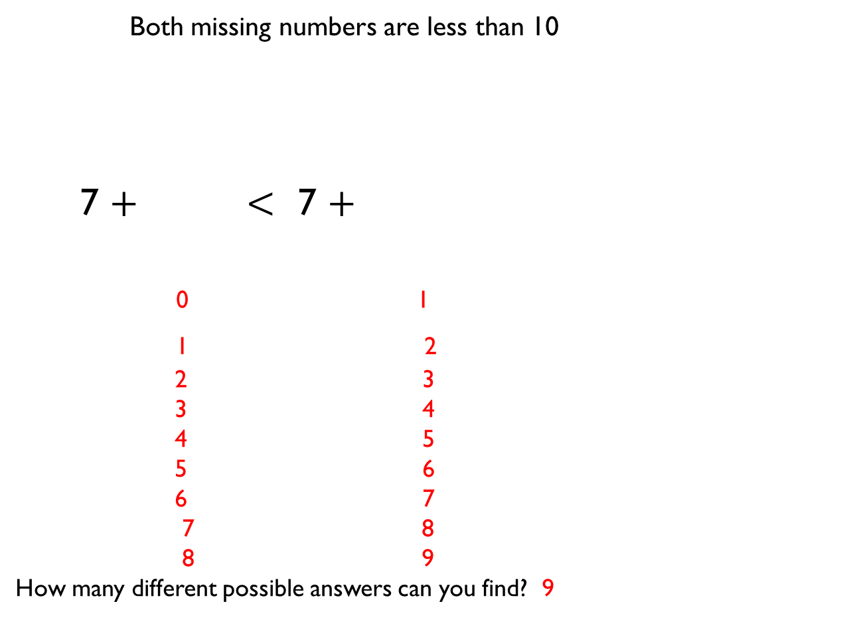
Both missing numbers are less than 10
7 $+$ $<$ 7 $+$
0 1
1 2
2 3
3 4
4 5
5 6
6 7
7 8
8 9
How many different possible answers can you find? 9

Slide 9
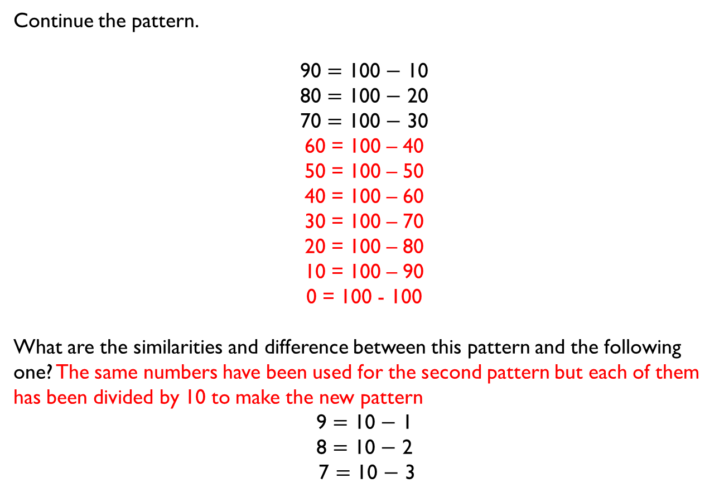
Continue the pattern.
90 $=$ 100 $−$ 10
80 $=$ 100 $−$ 20
70 $=$ 100 $−$ 30
60 = 100 – 40
50 = 100 – 50
40 = 100 – 60
30 = 100 – 70
20 = 100 – 80
10 = 100 – 90
0 = 100 - 100
What are the similarities and difference between this pattern and the following one? The same numbers have been used for the second pattern but each of them has been divided by 10 to make the new pattern
9 $=$ 10 $−$ 1
8 $=$ 10 $−$ 2
7 $=$ 10 $−$ 3

Slide 10

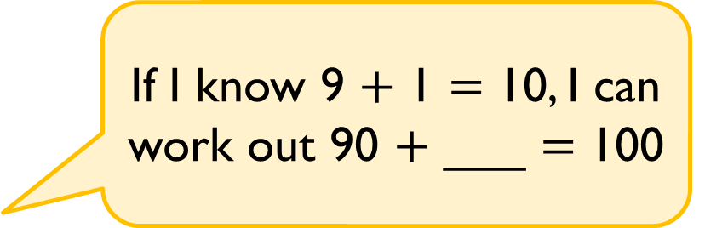
Alex says,
Find the missing number and explain how Alex knows. The missing number is 10 because you multiply each number by 10.
If I know 9 $+$ 1 $=$ 10, I can work out 90 $+$ ___ $=$ 100

Slide 11

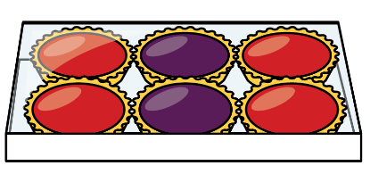
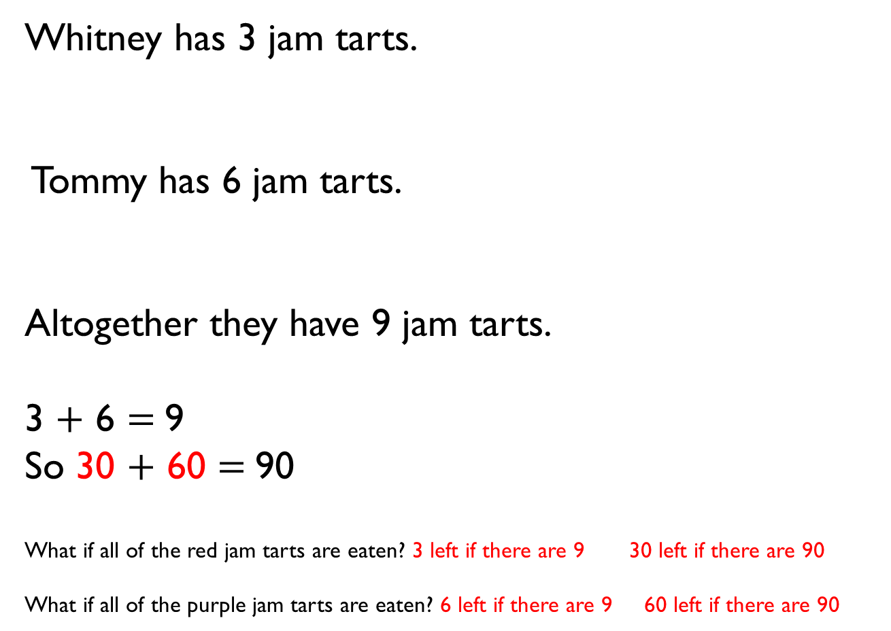
Whitney has 3 jam tarts.
Tommy has 6 jam tarts.
Altogether they have 9 jam tarts.
3 $+$ 6 $=$9
So 30 $+$ 60 $=$90
What if all of the red jam tarts are eaten? 3 left if there are 9 30 left if there are 90
What if all of the purple jam tarts are eaten? 6 left if there are 9 60 left if there are 90

Slide 12


Eva thinks,
Amir thinks,
Who is correct? Amir
Can you help the person who is wrong to understand their mistake?
10 + 80 = 90 20 + 70 = 90 30 + 60 = 90 40 + 50 = 90 50 + 40 = 90
There are 10 different number bonds to 90 using multiples of 10
There are only 5

Slide 13
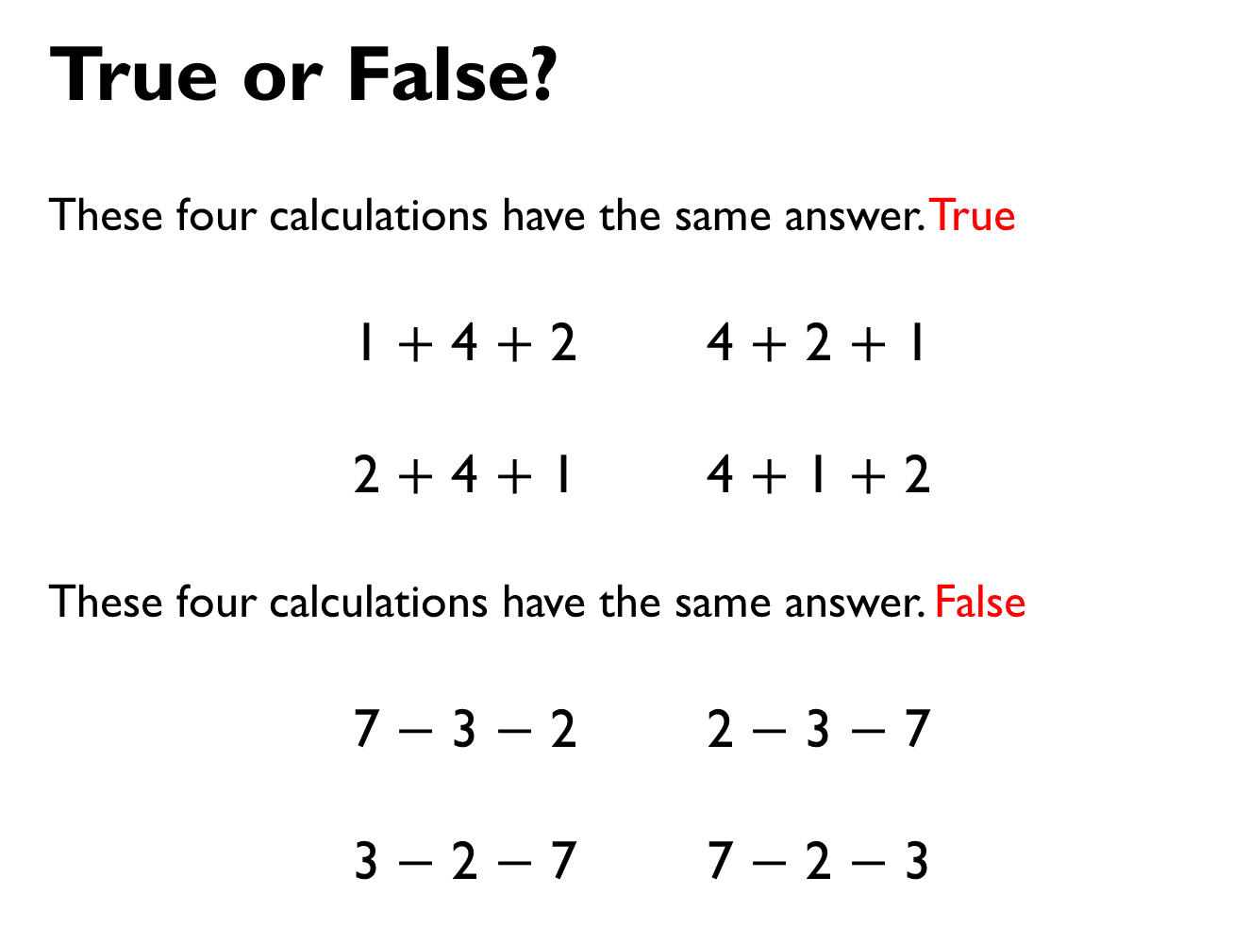
True or False?
These four calculations have the same answer. True
1 $+$ 4 $+$ 2 4 $+$ 2 $+$ 1
2 $+$ 4 $+$ 1 4 $+$ 1 $+$ 2
These four calculations have the same answer. False
7 $−$ 3 $−$ 2 2 $−$ 3 $−$ 7
3 $−$ 2 $−$ 7 7 $−$ 2 $−$ 3

Slide 14

Jack lives 5 km from school.
Annie lives 4 km from school in the same direction.
What is the distance between Jack and Annie’s houses? 1 km
After travelling to and from school, Jack thinks that he will walk 1 km more than Annie. Is he correct?
Explain your answer. False – he will walk 2km more as he has to walk 1km extra on the way and 1km extra on the way back
What will be the
difference in distance
walked after 2 school
days? 4km
Jack’s house
Annie’s house

Slide 15










SALE
The cost of each piece of fruit is reduced by 10 p.
What are the new prices?
35 p 25p
22 p 12p
68p 58p
15 p 5p

Slide 16


Class 2 gives one of their full packets of crayons away.
How many crayons do they have left? 43
Explain your reasoning. 53 – 10 = 43

Slide 17










Take 3 consecutive one-digit numbers, e.g. 4, 5 and 6.
Add them together. 2+3+4 =9 3+4+5 =12 4+5+6=15 5+6+7=18
What do you notice? The answers are multiples of 3
Choose different groups of 3 consecutive one-digit numbers and see if there is a pattern. 7+8+9=24 8+9+10=27 9+10+11=30 It goes up in 3’s if you increase each number by 1
8
2
3
5
7
6
4
1
9

