Slide 1




Year 2 - Summer
Measurement - ANSWERS

Slide 2
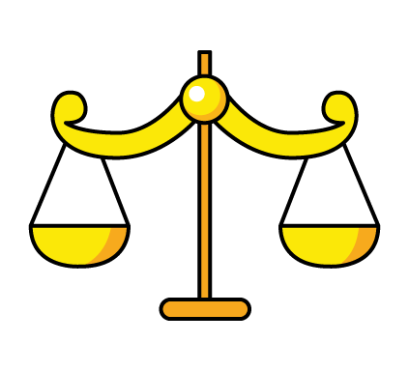

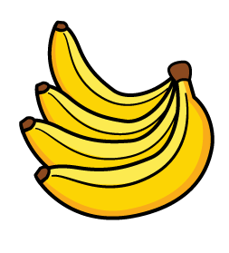


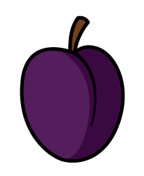
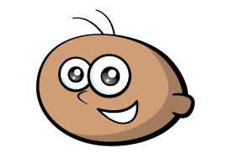
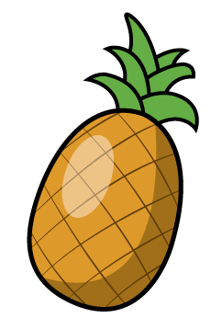
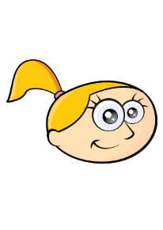
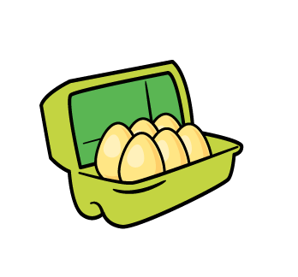
Tommy
Eva
Do you agree? TOMMY: 4 bananas = 8 cakes so 2 bananas = 4 cakes so 1 banana = 2 cakes. So 3 bananas = 2 apples so apples are heavier. EVA: 2 cakes = 1 banana so Eva is wrong.
Explain why.
Apples weigh more than bananas.
Two doughnuts weigh the same as two bananas.

Slide 3

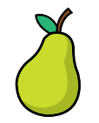

One pear weighs 10 cubes.
How many cubes will balance one pineapple?
Explain how you know. 20 cubes because 40 cubes balance 2 pineapples

Slide 4
Always, Sometimes or Never true?
The larger the box, the heavier it is.
Sometimes - because boxes can be made from different materials – card board, wood, metal etc

Slide 5
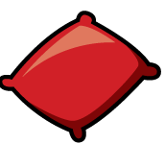


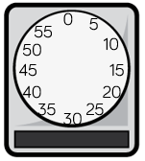
Which is heavier, the red or the green beanbag?
Explain why. Red beanbag because 2 green beanbags are the same as 1 red beanbag

Slide 6


The weighs 25 g.
The weighs 30 g.

Slide 7
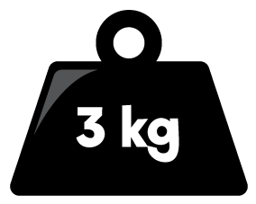
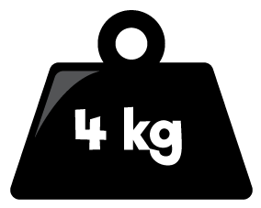
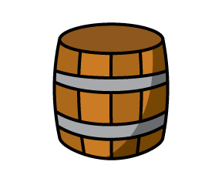

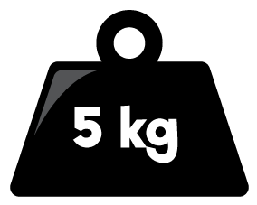


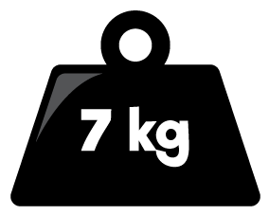
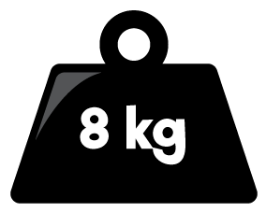
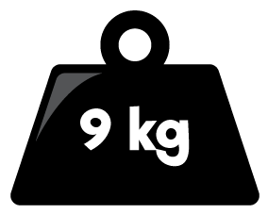
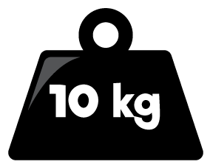

What is the mass of each barrel?
8kg
Double the mass of A 16kg
Half the mass of A 4kg
What is the difference between the mass of B and C? 12kg
A
B
C

Slide 8
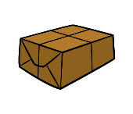
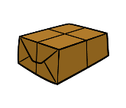

The brown parcel weighs twice as much as the blue parcel.
The green parcel weighs 2 kg more than 30 kg
The blue parcel weighs 12 kg less than the green parcel.
Draw an arrow to show where each parcel would be on the scale.
0
10
20
30
40

Slide 9
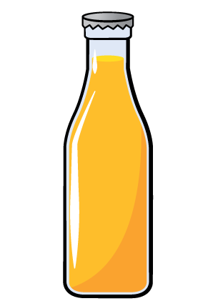
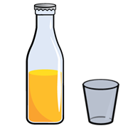
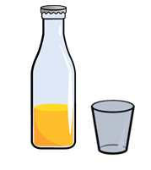
Whitney had two full bottles of juice.
She poured some juice into two glasses.
A B
Which glass has the most juice in? B
Which has the least juice in? A
Explain how you know. There is less left in bottle B

Slide 10
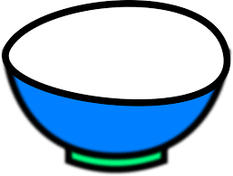

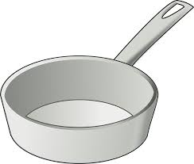
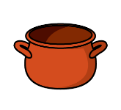
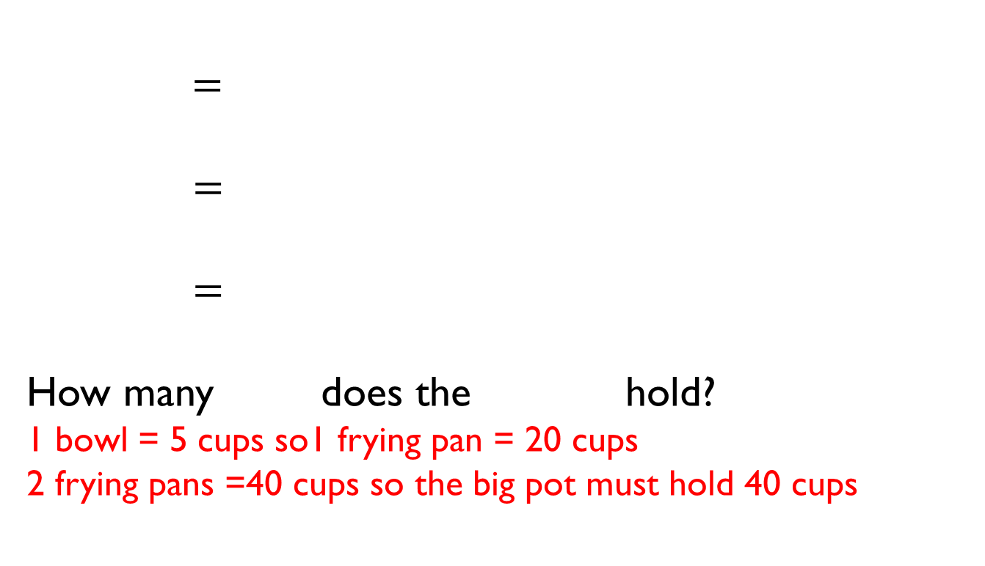
$=$
$=$
$=$
How many does the hold?
1 bowl = 5 cups so1 frying pan = 20 cups
2 frying pans =40 cups so the big pot must hold 40 cups

Slide 11
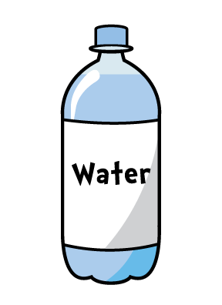
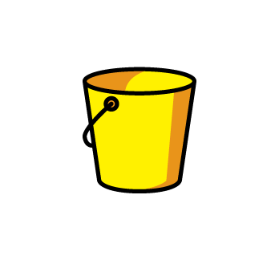
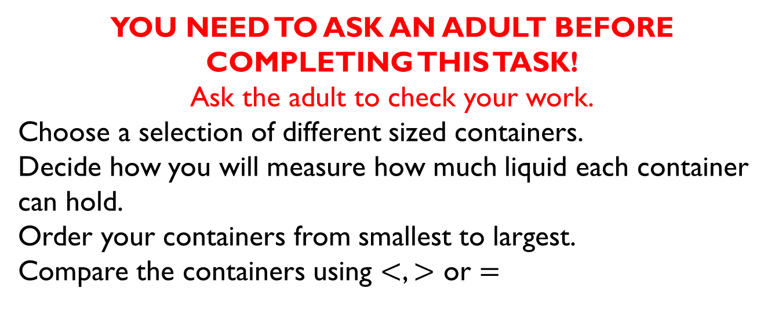
YOU NEED TO ASK AN ADULT BEFORE COMPLETING THIS TASK!
Ask the adult to check your work.
Choose a selection of different sized containers.
Decide how you will measure how much liquid each container can hold.
Order your containers from smallest to largest.
Compare the containers using $<$, $>$ or $=$

Slide 12
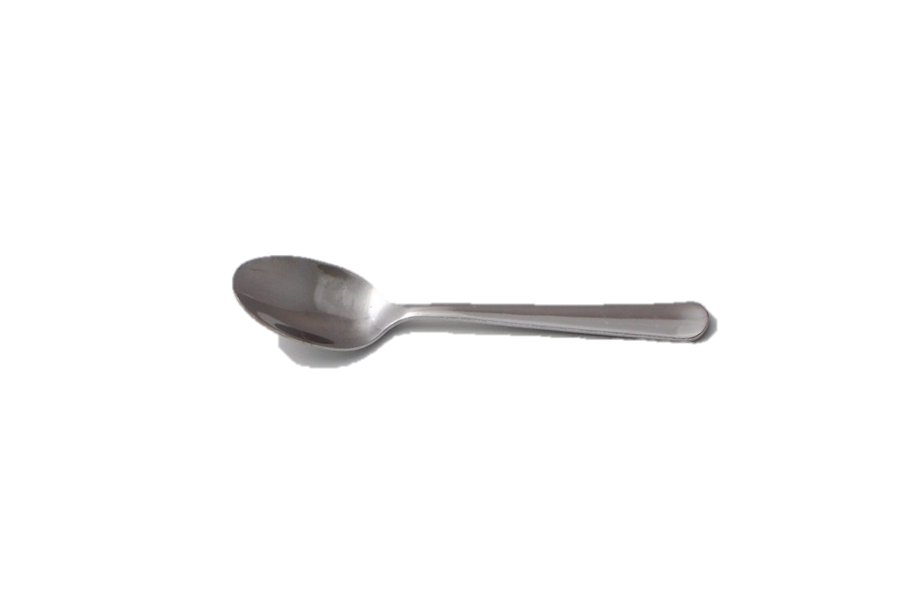
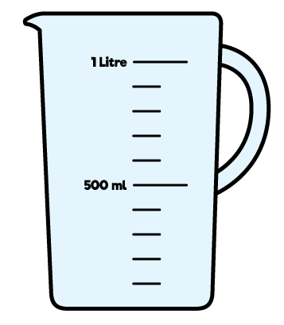
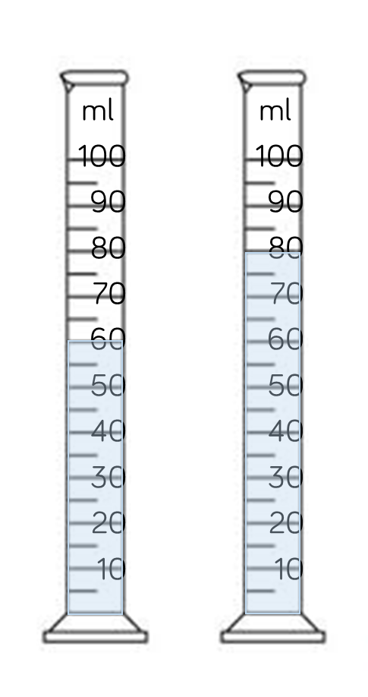
A holds 5 ml of liquid.
How many of liquid are there in each container?
A = 12 spoons B = 16 spoons
100 ml
100 ml
50 ml
50 ml

Slide 13
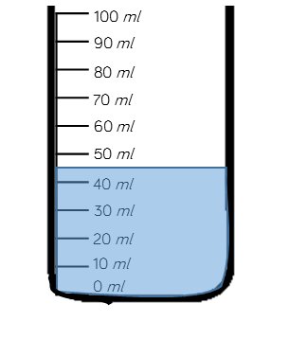
Estimate the amount of water in the container.
About 45ml
Explain why you have given your answer. About 45ml because it’s half way between the 40ml and the 50ml
100 ml
100 ml
50 ml
50 ml

Slide 14
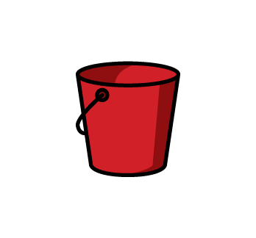
Mo puts 4 litres of water in bucket A.
He then pours 3 litres from bucket A into bucket B.
A B
Which sentence is correct?
There is more in bucket A. False
There is less in bucket A. True
There are equal amounts in each bucket. False
Explain why. There were 4 litres in A but then he poured 3 of the litres into B – So A has 1 litre and B has 3 litres

Slide 15
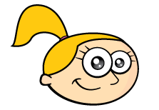
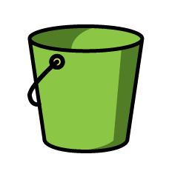
Eva wants to measure 2 litres of water into a tub. She only has a 5 litre and a 3 litre container.
How can she use both containers to measure 2 litres?
She should fill the 5L tub and then use that water to fill the 3L tub. This will leave her with 2L in the green tub.
5 l
3 l

Slide 16
Mollie took the temperature at 12 p.m. and again at 5 p.m.
There was a difference of 7°C
What could the temperatures be?
13°C and 20°C 14°C and 21°C 15°C and 22°C

