Slide 1
The Wright Brothers
https://www.youtube.com/watch?v=RriKI7u72Xs

Slide 2
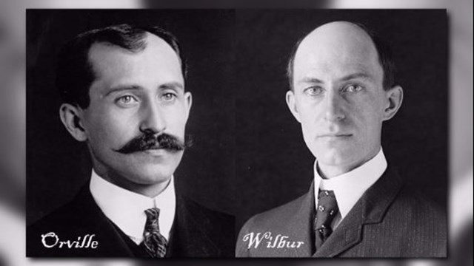
The brothers were called Wilbur and Orville

Slide 3
Growing up they both loved inventing lots of different things.
They became interested in flying when their Dad gave them a toy helicopter that flew with the help of an elastic bands.
The brothers started by building kites and then progressed onto gliders.

Slide 4
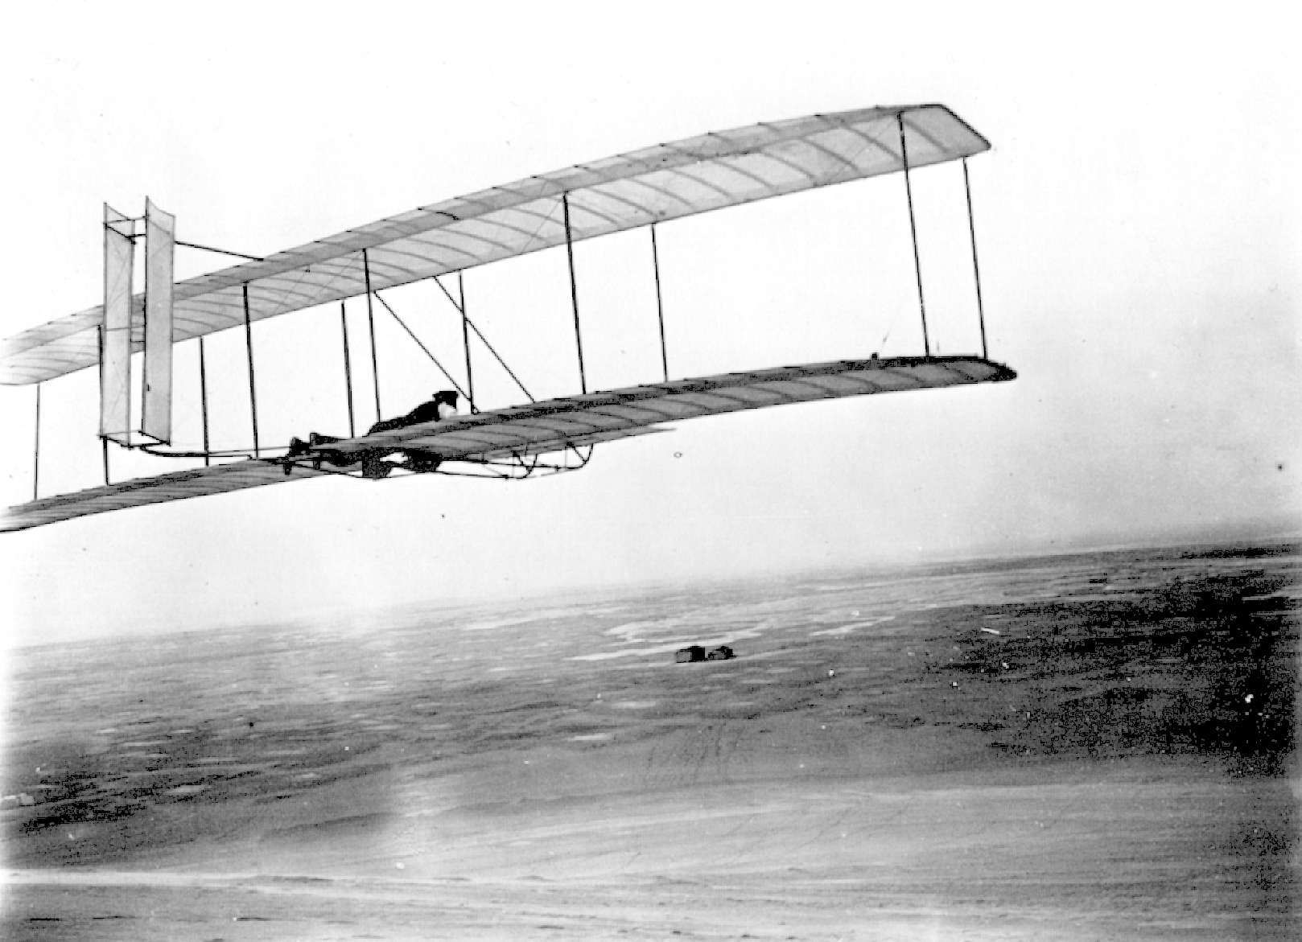
In December 1903 they became the first to make a successful human flight with a craft that was powered by an engine. The flight lasted for 12 seconds.

Slide 5
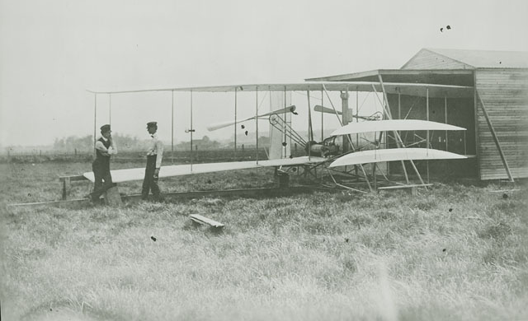
In November 1904, using a newly designed craft named Flyer II, Wilbur took to the skies.
This flight lasted for over 5 minutes.

Slide 6
They had to work hard and experimented for years with gliders to perfect the wing design and controls.
Then they had to learn how to make efficient propellers and a lightweight engine for the powered flight.
There was a lot of technology, know how, and courage involved in making that first flight.

