Slide 1

Trees

Slide 2

Today we are learning about the parts of a tree

Slide 3
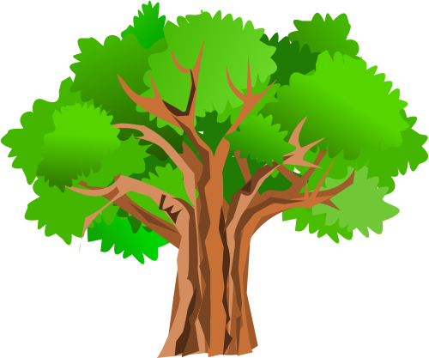
Do you know any parts of a tree already?
Tell your partner

Slide 4

  Crown
  The crown is made up of the leaves and branches at the top of a tree
  Twig
  this is where the buds, fruits and flowers of the tree are
  Branch
  provide the support to distribute the leaves efficiently
  Leaves
gather water and nutrients for the tree
Roots
They gather water and nutrients to help the tree grow
  Trunk
supports the leaves and the branches of the tree

Slide 5
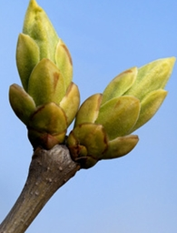
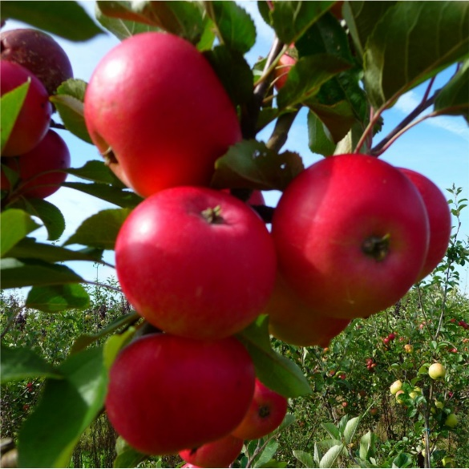
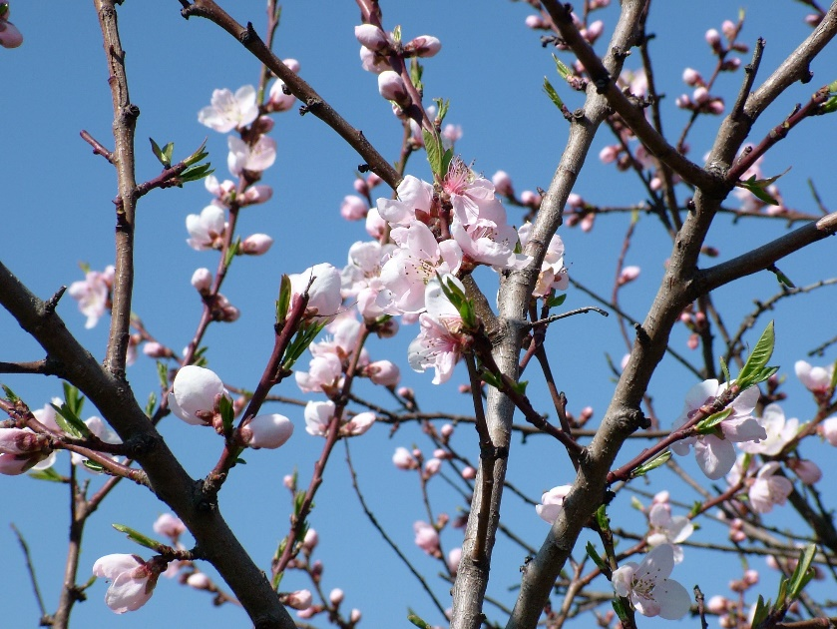
Buds, fruit and flowers
A bud is an undeveloped shoot from which leaves or flower parts grow.
The fruits of the tree is the part which you can eat like on an apple tree.
Flowers are show bit of the tree. They attract insects to help pollination.

