Slide 1
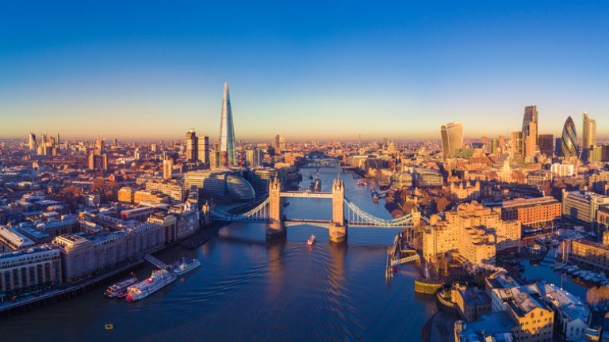

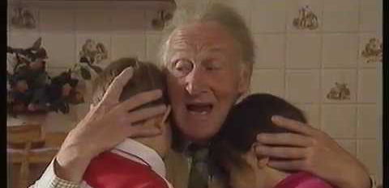
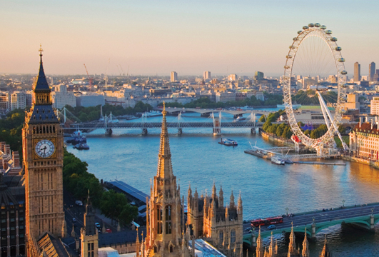
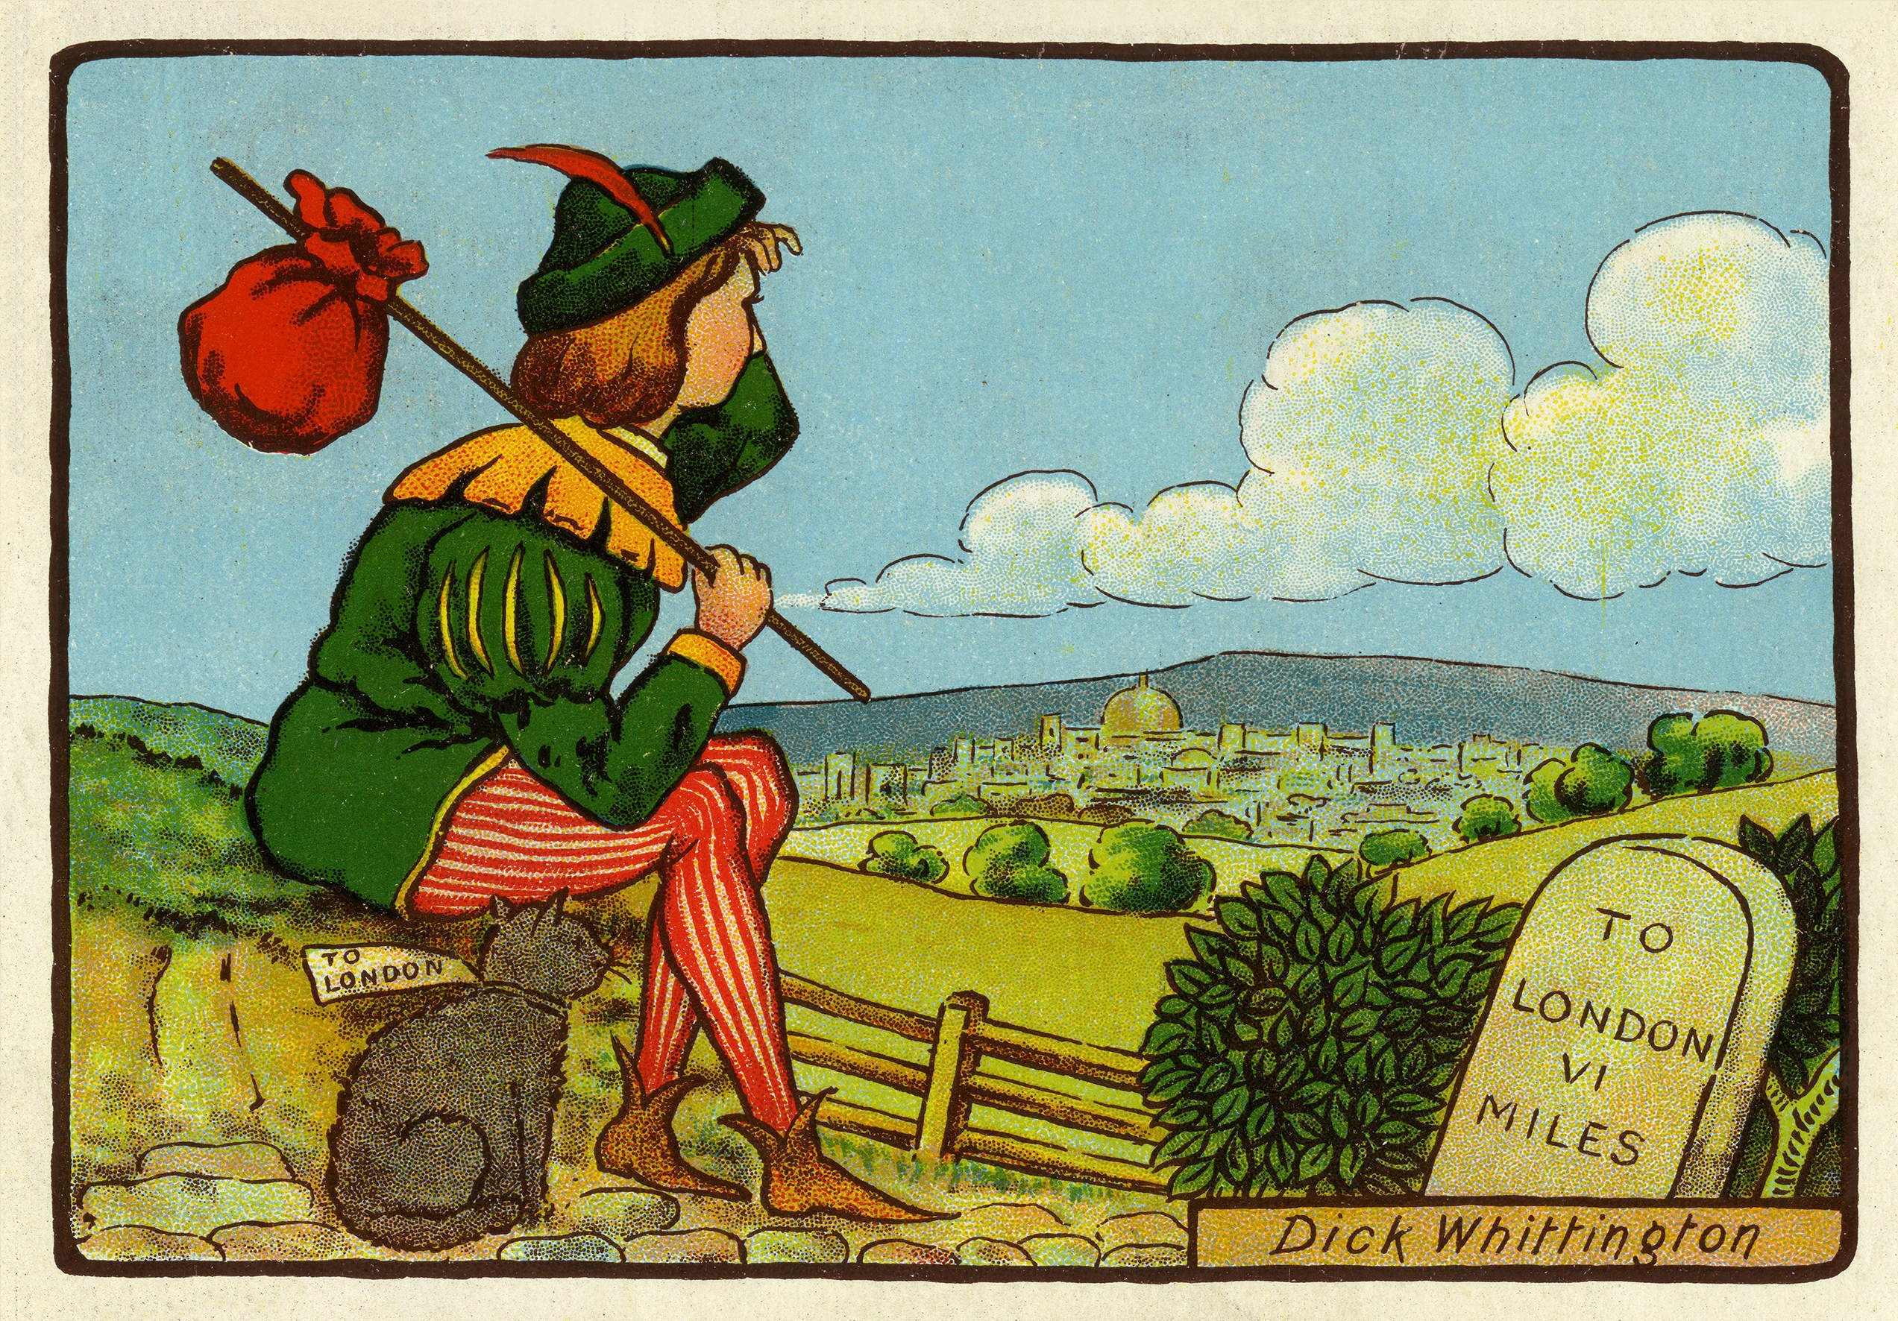
Visual Literacy
We will watch and respond to the BBC short drama ‘Magic Grandad’.
During this we will:
Use Phantom Predictor’s skills to work out what will happen from the actions of characters.
Use Dark Decoder’s skills to look at the language that the characters use.
Use Crimson Clue Hunter’s skills to work out how characters feel about events.
London Calling
Comprehension
We will read information texts about London.
During this we will:
Use Dark Decoder’s skills to work out the meaning of new and technical vocabulary.
Use Rocket Retriever’s skills to find key events and information.
Traditional Tales
We read and perform traditional tales based in and around London, such as ‘Dick Whittington’ and ‘The Pied Piper’.
During this we will:
Use Sequencing and Summarising Shadow’s skills to put the events of the tales in order and retell them.
Use Rocket Retriever’s skills to find key information in the story and to identify similar language and features of fairy tales.
Use Phantom Predictor to work out what will happen based on fairy tale conventions.
Write a diary entry from the point of view of Dick Whittington.
Grammar: Nouns and Noun Phrases
We will learn about different types of nouns and how to describe them.
During this we will learn how to:
Identify and use concrete and proper nouns.
Use articles (the) and determiners to introduce nouns.
Use pronouns (I, he, she, they) to replace nouns.
Use adjectives to describe nouns and build simple noun phrases.
Use commas to separate adjectives in noun phrases.
Non-Fiction: Recount
We will find out Samuel Pepys and the Great Fire of London.
During this we will:
Use Dark Decoder’s skills to work out the meaning of new and technical vocabulary.
Use Sequencing and Summarising Shadow’s skills to put events in order.
Use Rocket Retriever’s skills to find key events and information.
Write a diary entry based on the Great Fire of London.
Notes:
1

