Slide 1







St Anselm’s Catholic Primary School
Virtual Sports Week
29th June – 3rd July 2020

Slide 2

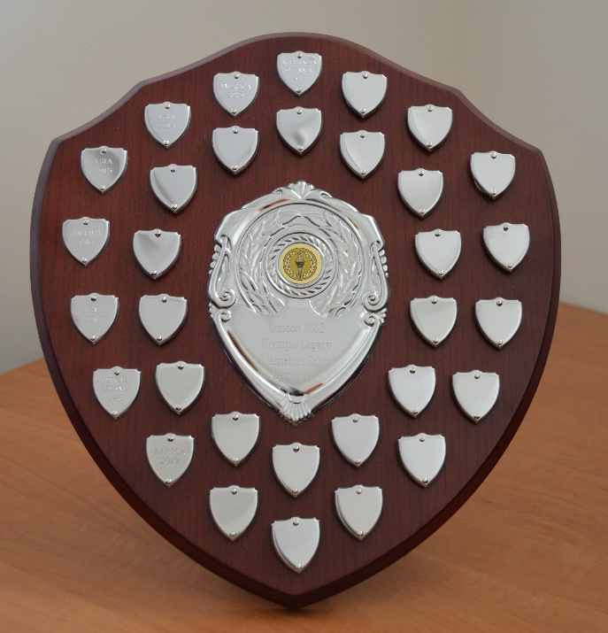
This year, we are unable to have our annual Sports Week. Never fear, we can have a virtual one instead! Which team will be victorious?
Will Team Africa be able to defend their title?
It is all up for grabs in our virtual competition!
Physical activity has never been so important in our lives, proving that sport can bring people together, helping us try something new and positively impact our mental health.

Slide 3
As you will see, the activities are quite different this year.
They are planned so that they require minimal resources; hopefully you can use regular household items to help you!.
The aim of the game is to HAVE FUN whilst earning your team points at the same time.
So, whether you are at home or in school, you will be able to enjoy all of the fun, excitement and friendly competition that Sports Week usually brings!

Slide 4
On the next slides you will find the ten activities with instructions.
There is also information about how to score and complete the sheet.
If you can, take a photo of yourself completing one of the activities
and send it to us with you score sheet.
Children in Y3, Y4, Y5 and Y6 should upload their score sheet and photo to Google Classroom.
Children in YR, Y1 and Y2 should send their score sheet and photo to the office via email secretary@st-anselms.kent.sch.uk

Slide 5
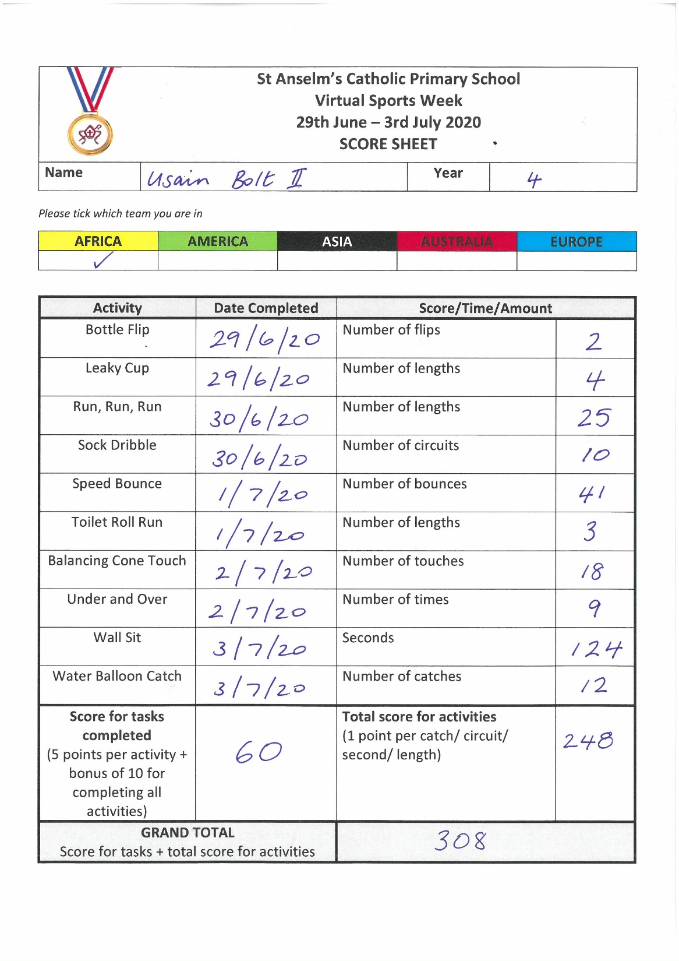
Scoring System
5 points for completing an activity.
1 point per catch/circuit/second/length – so make sure you are counting as you go along!
An extra 10 points if you complete every activity.

Slide 6
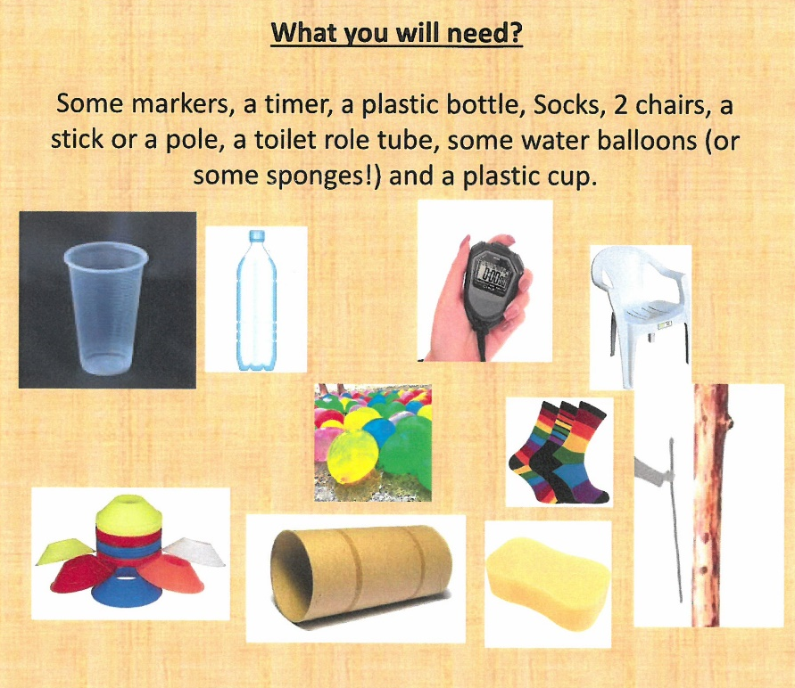

Slide 7
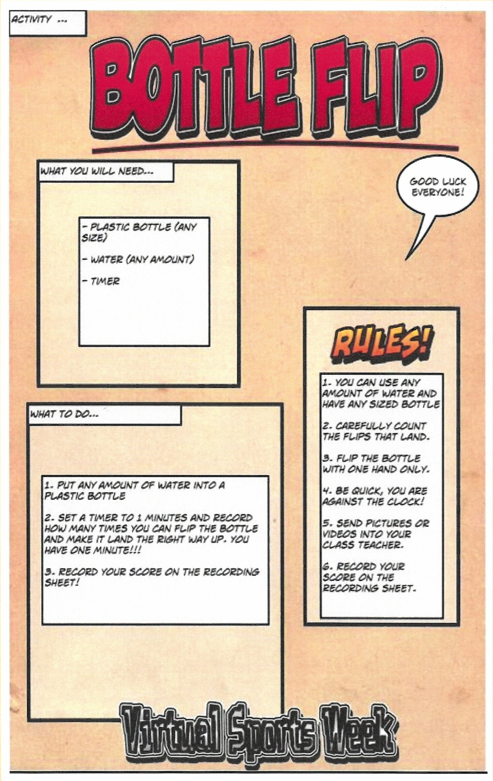

Slide 8
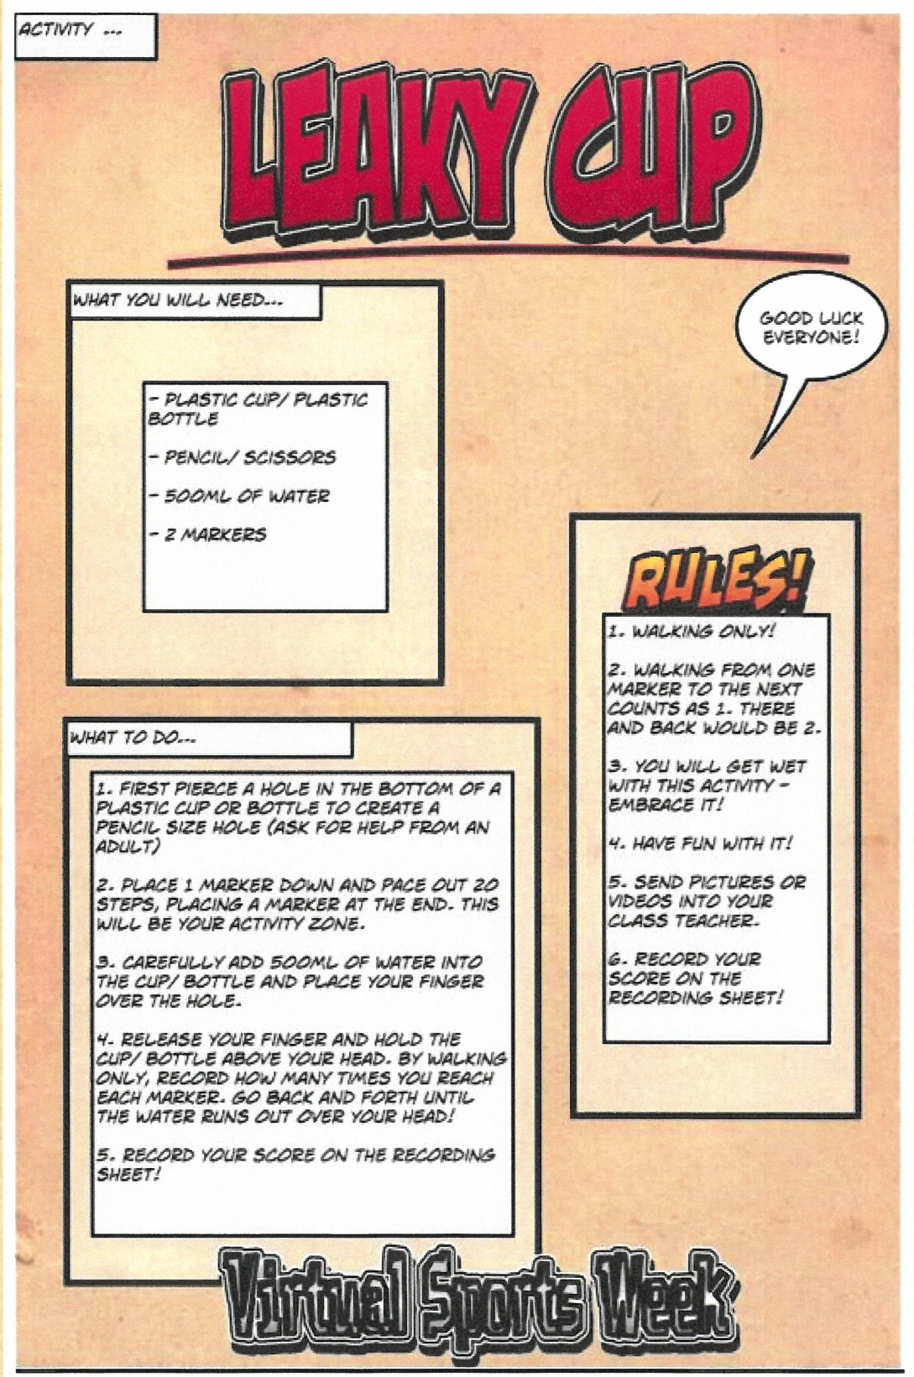

Slide 9
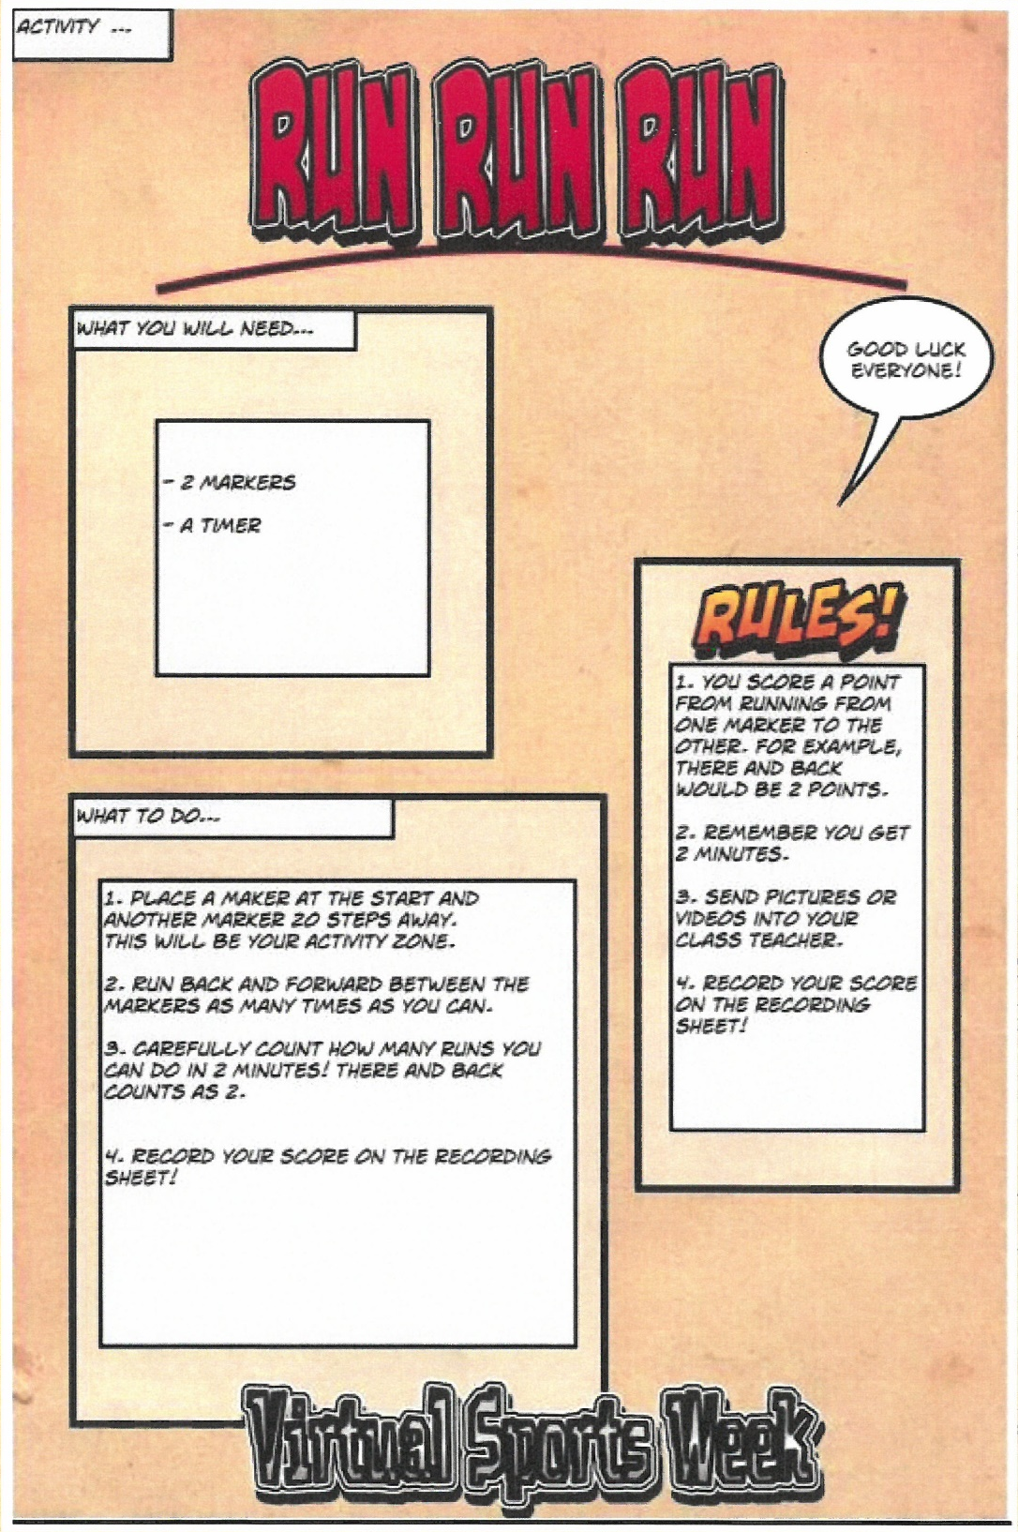

Slide 10
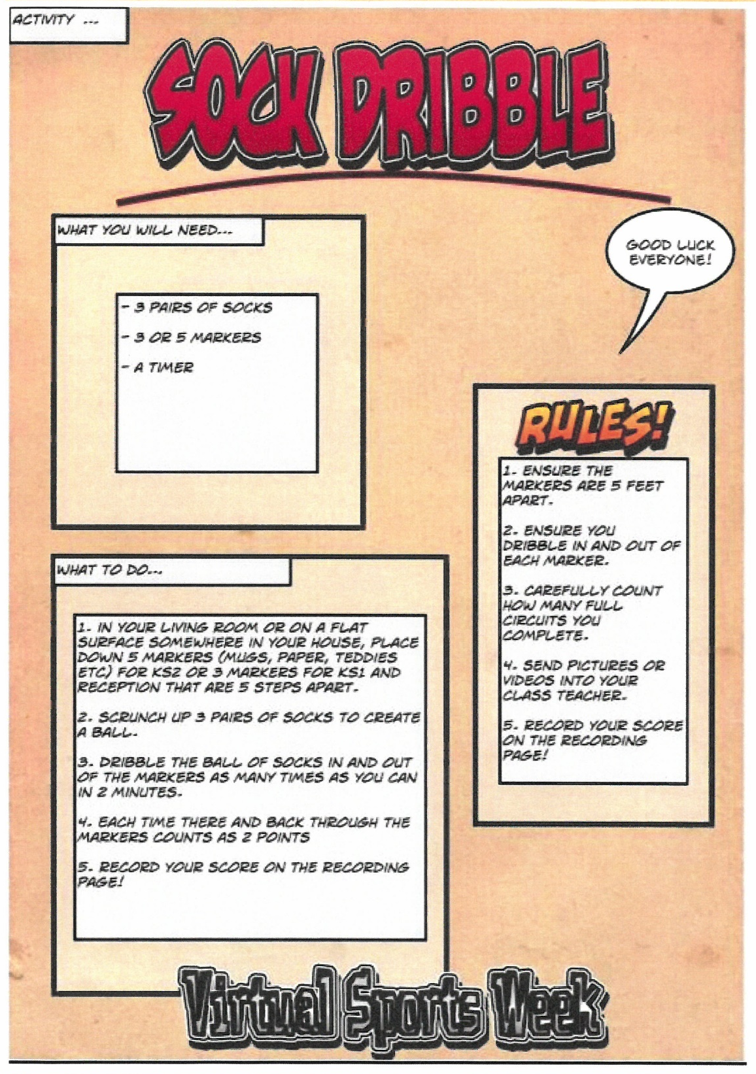

Slide 11
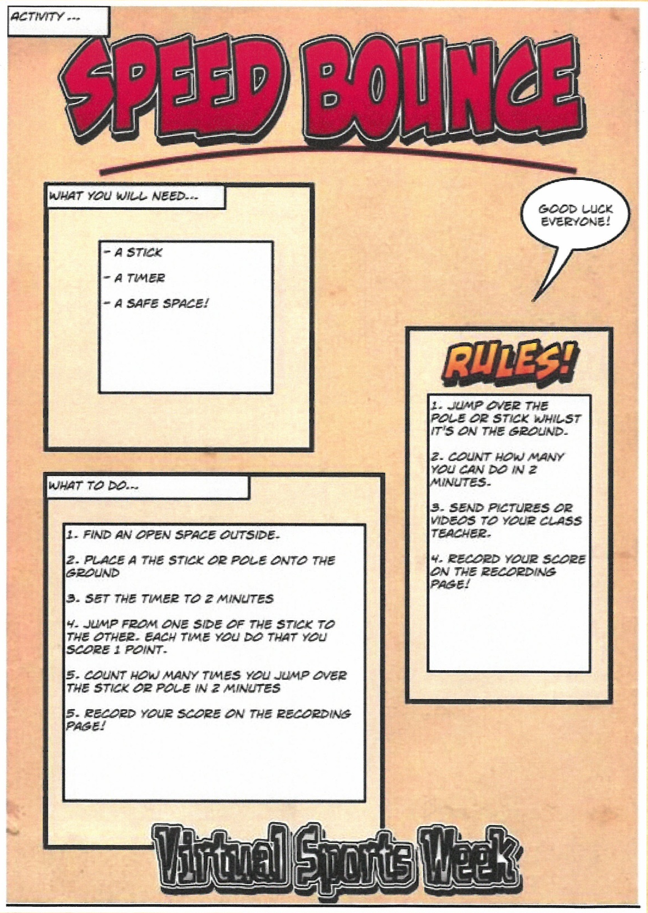

Slide 12
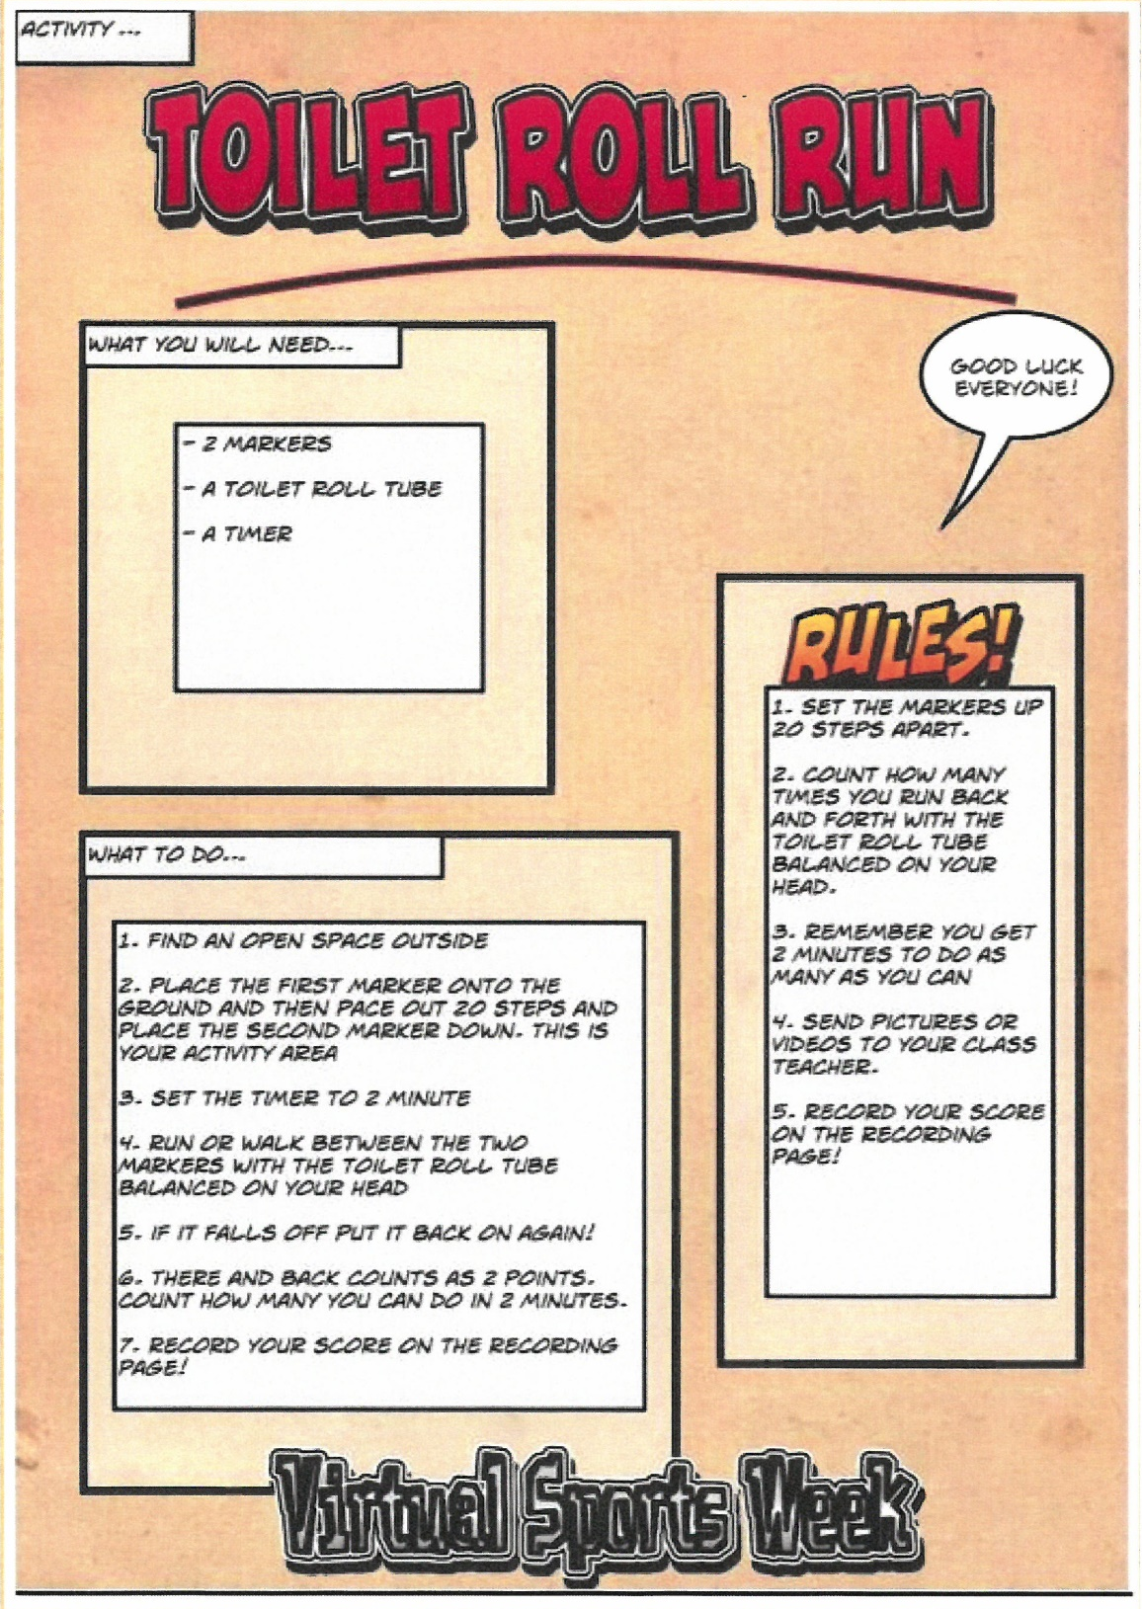

Slide 13
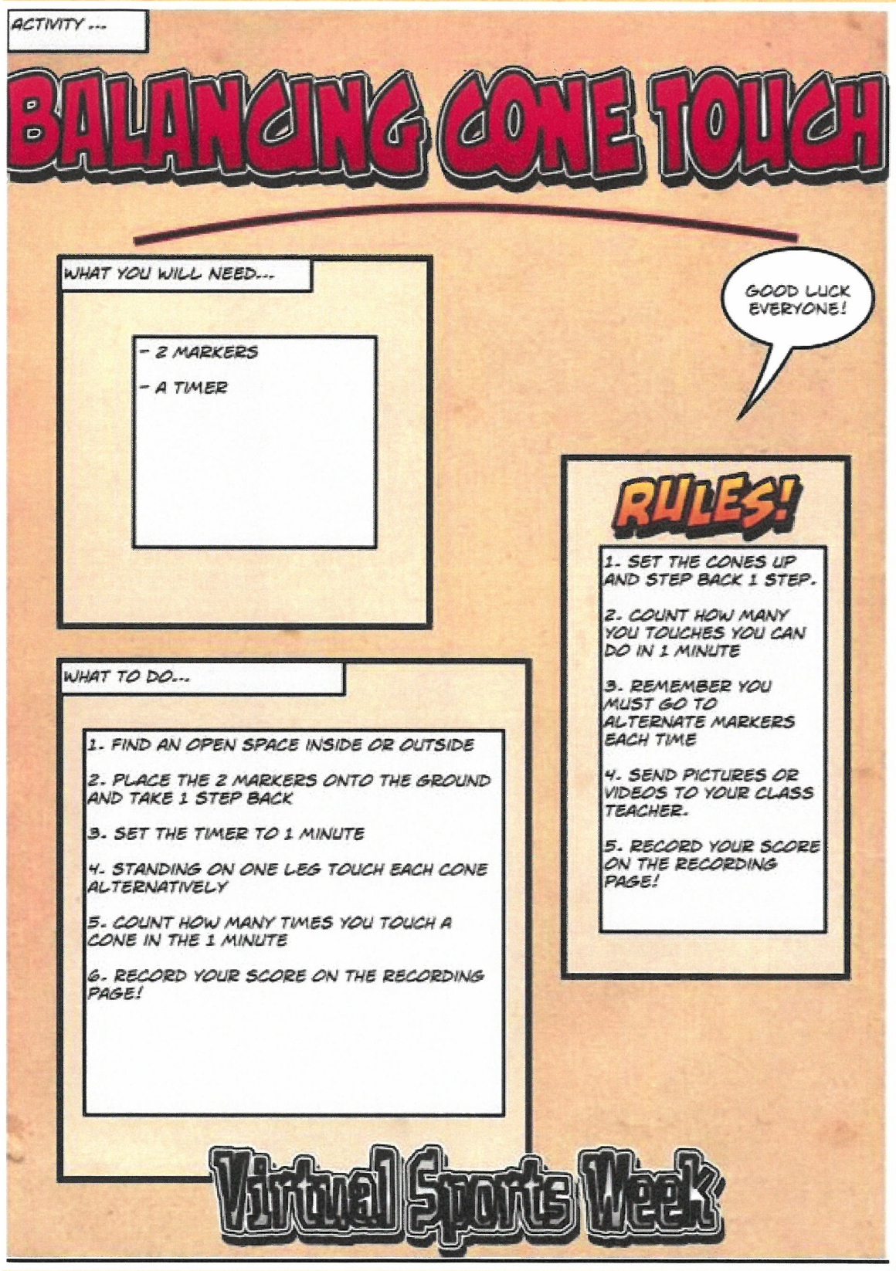

Slide 14
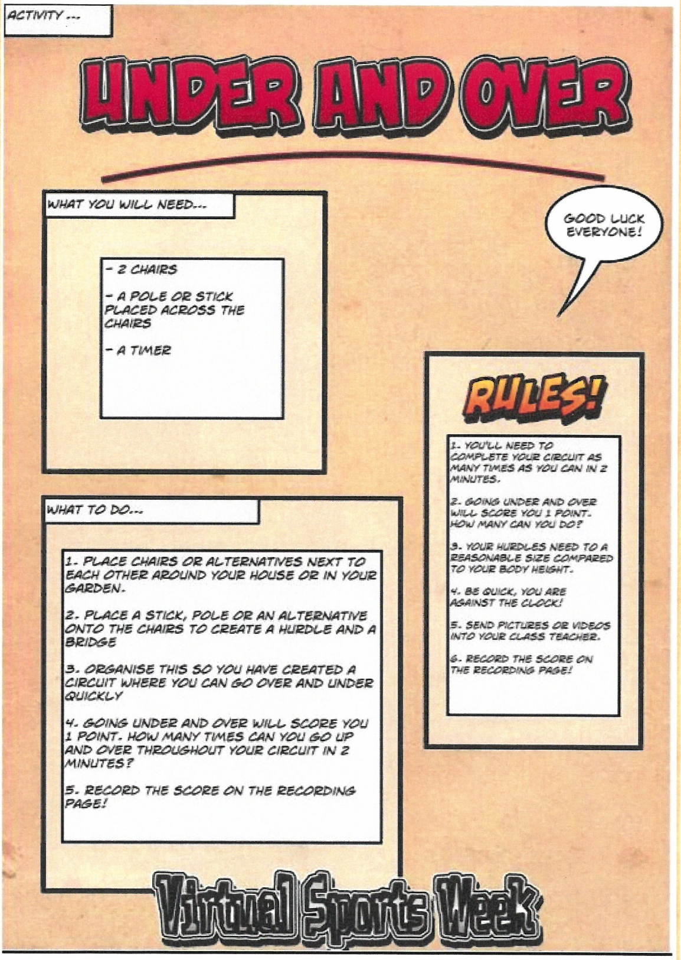

Slide 15
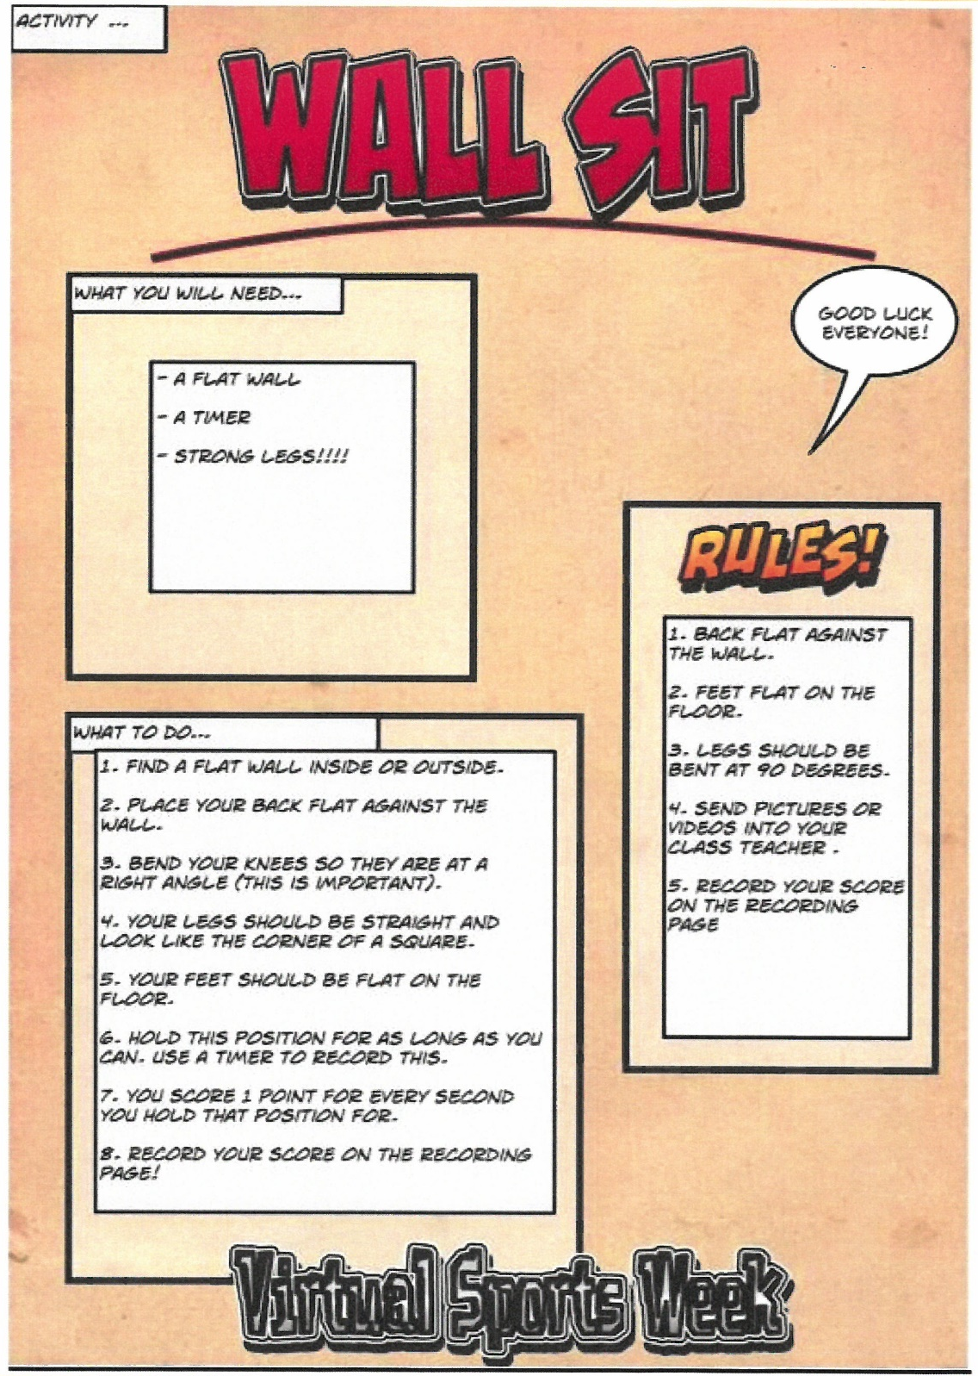

Slide 16
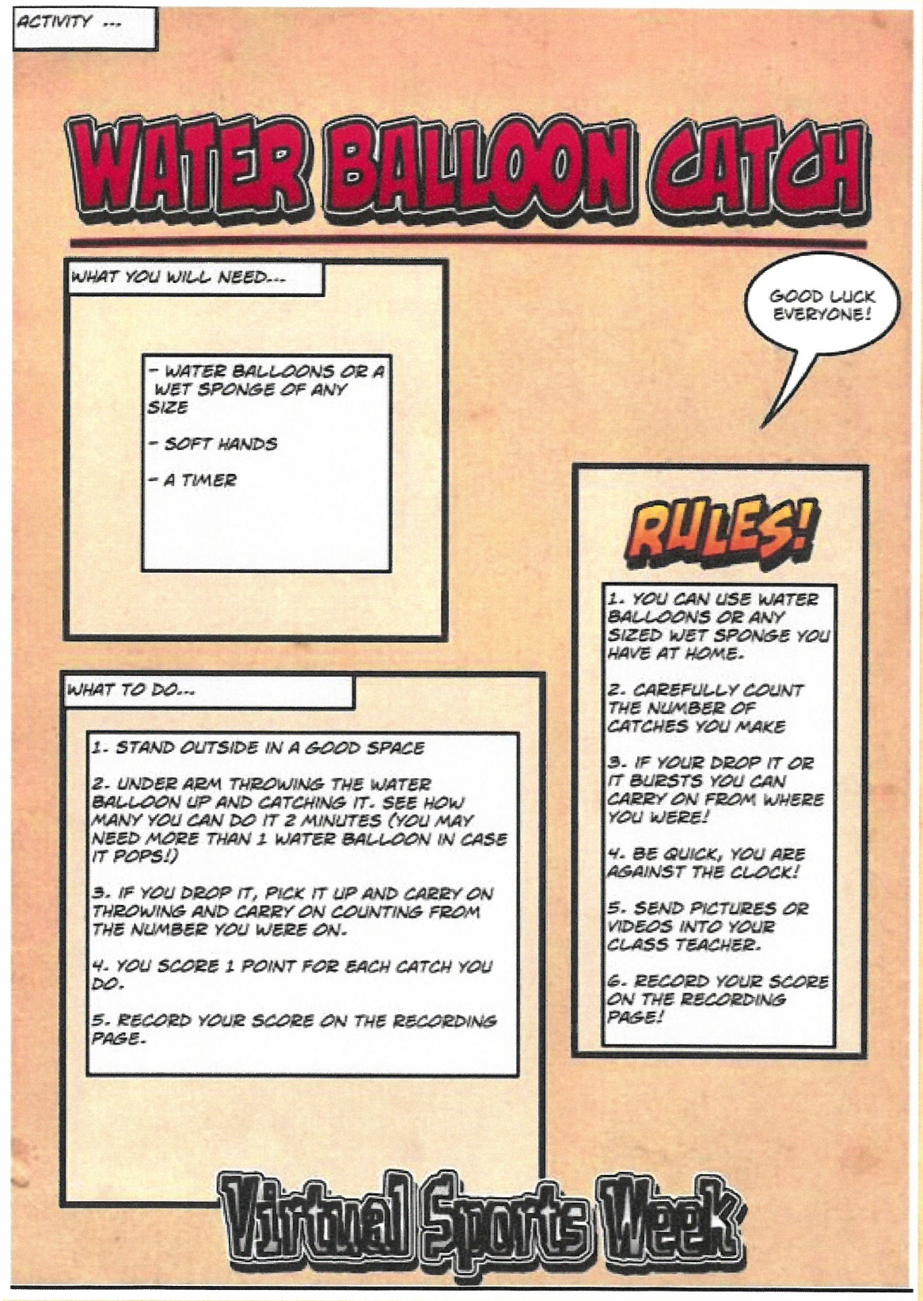

Slide 17
Read the instructions
Complete 2 challenges each day
Log your score
Win points for your team
Send us your score sheet and photos
by Midday on Friday 3rd July
We’ll add up the scores & announce the winners on Monday 6th July!
Good Luck and have lots of fun!

